Slide 1
Bioinformatics for Whole-Genome Shotgun Sequencing of Microbial Communities
By Kevin Chen, Lior Pachter
PLoS Computational Biology, 2005
David Kelley

Slide 2
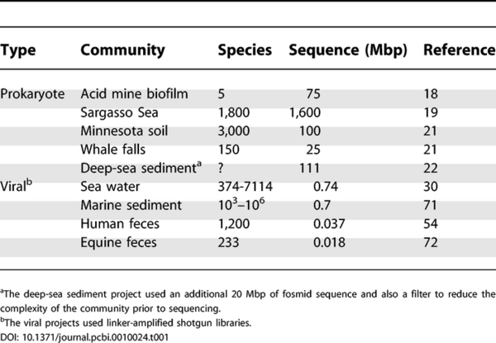
State of metagenomics
In July 2005, 9 projects had been completed.
General challenges were becoming apparent
Paper focuses on computational problems

Slide 3
Assembling communities
Goal
Retrieval of nearly complete genomes from the environment
Challenges
Need sufficient read depth- species must be prominent
Avoid mis-assembling across species while maximizing contig size

Slide 4
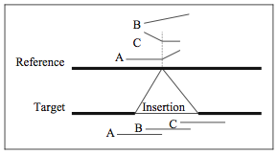
Comparative assembly
Align all reads to a closely-related “reference” genome
Infer contigs from read alignments
Rearrangements limit effectiveness
Pop M. et al. Comparative genome assembly. Briefings in Bioinformatics 2004.

Slide 5
“Assisted” Assembly
De novo assembly
Complement by aligning reads to reference genome(s)
Short overlaps can be trusted
Single mate links can be trusted
Mis-assemblies can be detected
Gnerre S. et al. Assisted assembly: how to improve a de novo genome assembly by using related species. Genome Biology 2009.

Slide 6
Assisted Assembly
Gnerre S. et al. Assisted assembly: how to improve a de novo genome assembly by using related species. Genome Biology 2009.

Slide 7
Assisted Assembly
Gnerre S. et al. Assisted assembly: how to improve a de novo genome assembly by using related species. Genome Biology 2009.

Slide 8
Assisted Assembly
Gnerre S. et al. Assisted assembly: how to improve a de novo genome assembly by using related species. Genome Biology 2009.

Slide 9
Metagenomics application
Pros:
Low coverage species
If conservative, unlikely to hurt
Cons
Exotic microbes may have no good references
Potential to propagate mis-assemblies

Slide 10
Overlap-layout-consensus
Species-level
Increased polymorphism
Reads come from different individuals
Missed overlaps
System-level
Homologous sequence
False overlaps

Slide 11
Polymorphic diploid eukaryotes
Reads sequenced from 2 chromosomes
Single reference sequence expected
Keep duplications separate
Keep polymorphic haplotypes together

Slide 12
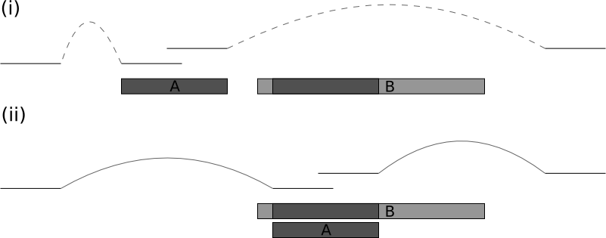
Strategy 1
Form contigs aggressively
Detect alignments between contigs and resolve
Avoid merging duplications by respecting mate pair distances
Jones, T. et al. The diploid genome sequence of Candida albicans. PNAS 2004.

Slide 13
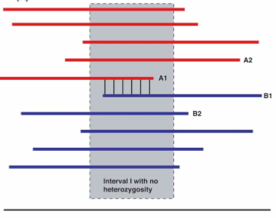
Strategy 2
Assemble chromosomes separately
Erase overlaps with splitting rule
Vinson et al. Assembly of polymorphic genomes: Algorithms and application to Ciona savignyi. Genome Research 2005.

Slide 14
Back to metagenomics
Strategy 1
Assemble aggressively
Detect mis-assemblies and fix
Strategy 2
Separate reads or filter overlaps

Slide 15
Binning
Presence of informative genes
E.g. 16S rRNA
Machine learning
K-mers
Codon bias
Worked well only with big scaffolds
Lots of progress in this area since 2005

Slide 16
Abundances
Depth of read coverage suggests relative abundance of species in sample
Difficult if polymorphism is significant
Separate individuals → too low
Merge species → too high
Depends on good classification

Slide 17
How much sequencing
G = genome size (or sum of genomes)
c = global coverage
k = local coverage
n_{k}= bp w/ coverage k

Slide 18
Poisson model
x-l_{r}
x
“Interval” =[x – l_{r} , x]
“Events” = read starts
“λ” = coverage

Slide 19
Gene Finding
Focus on genes, rather than genomes
Bacterial gene finders are very accurate
Assemble and run on scaffolds
BLAST leftover reads against protein db

Slide 20
Partial genes
Tested GLIMMER on simulated 10 Kb contigs
Many genes crossed borders
GLIMMER often predicted a truncated version
Gene finding models could be adjusted to account for this case

Slide 21
Gene-centric analysis
Cluster genes by orthology
Orthology refers to genes in different species that derive from a common ancestor
Express sample as vector of abundances

Slide 22
UPGMA on KEGG vectors

Slide 23
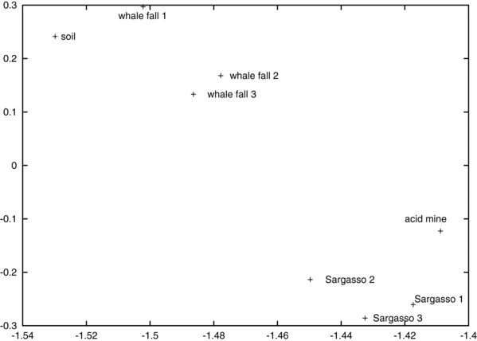
PCA on KEGG vectors
Principal components may correspond to interesting pathways or functions

Slide 24
How much sequencing
N = # genes in community
f = fraction found
Coupon collector’s problem

Slide 25
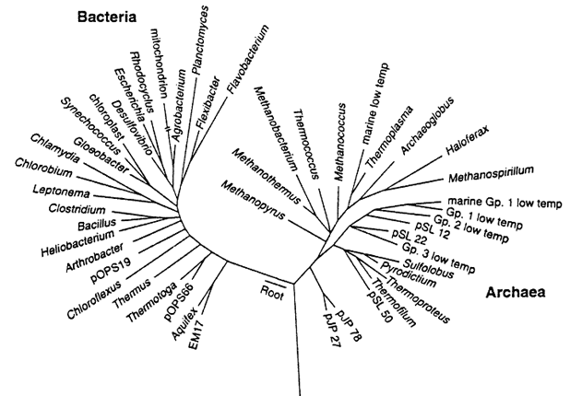
Phylogeny
Apply multiple sequence alignment and phylogeny reconstruction to gene sequences

Slide 26
Partial sequences
Bad for common msa programs
Semi-global alignment is required

Slide 27
Supertree methods
Construct tree from multiple subtrees
Split gene into segments?
Construct subtree on sequences that align fully to segment?

Slide 28
Thanks!

