Slide 1
Prediction of effective genome size in metagenomics samples
Jeroen Raes, Jan O Korbel, Martin J Lercher, Christian von Mering and Peer Bork
Presented by Daehwan Kim

Slide 2
Outline
Genome size
Genome sizes of Archaea, Bacteria, and Eukaryotes
Factors affecting genome and genome sizes
Review of genes and a power rule for their numbers
Classical approaches for estimating genome size and their drawbacks
A new approach based on the density of particular genes: Effective Genome Size (EGS)
Genes used for estimating genome size and formula
Predicted EGS on 32 complete genome shotgun datasets from NCBI
Predicted EGS on 12 environmental samples (AMD, Soil, Sargasso, and so on)
Formula derivation and its application for a mixture of species

Slide 3
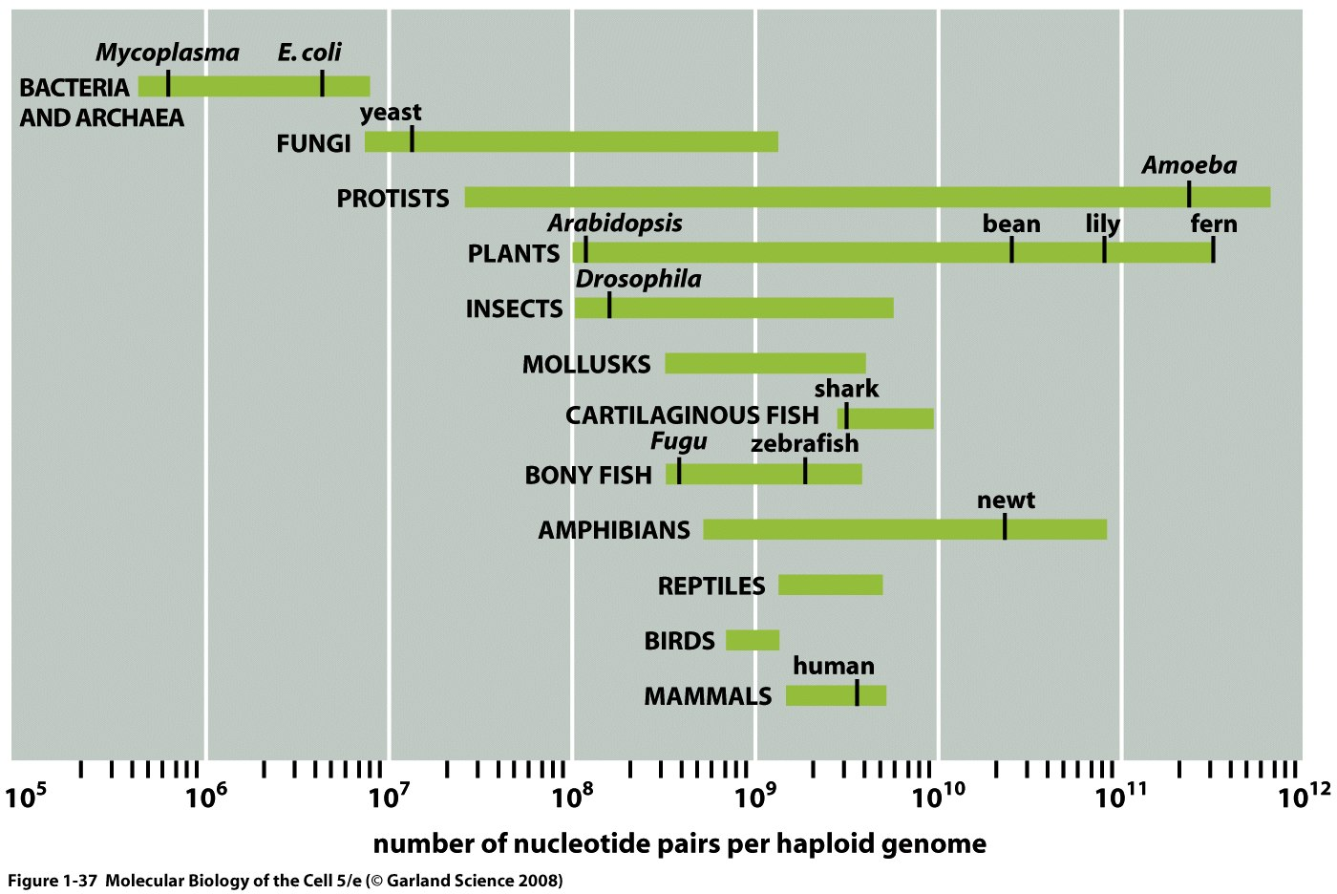
Genome size

Slide 4
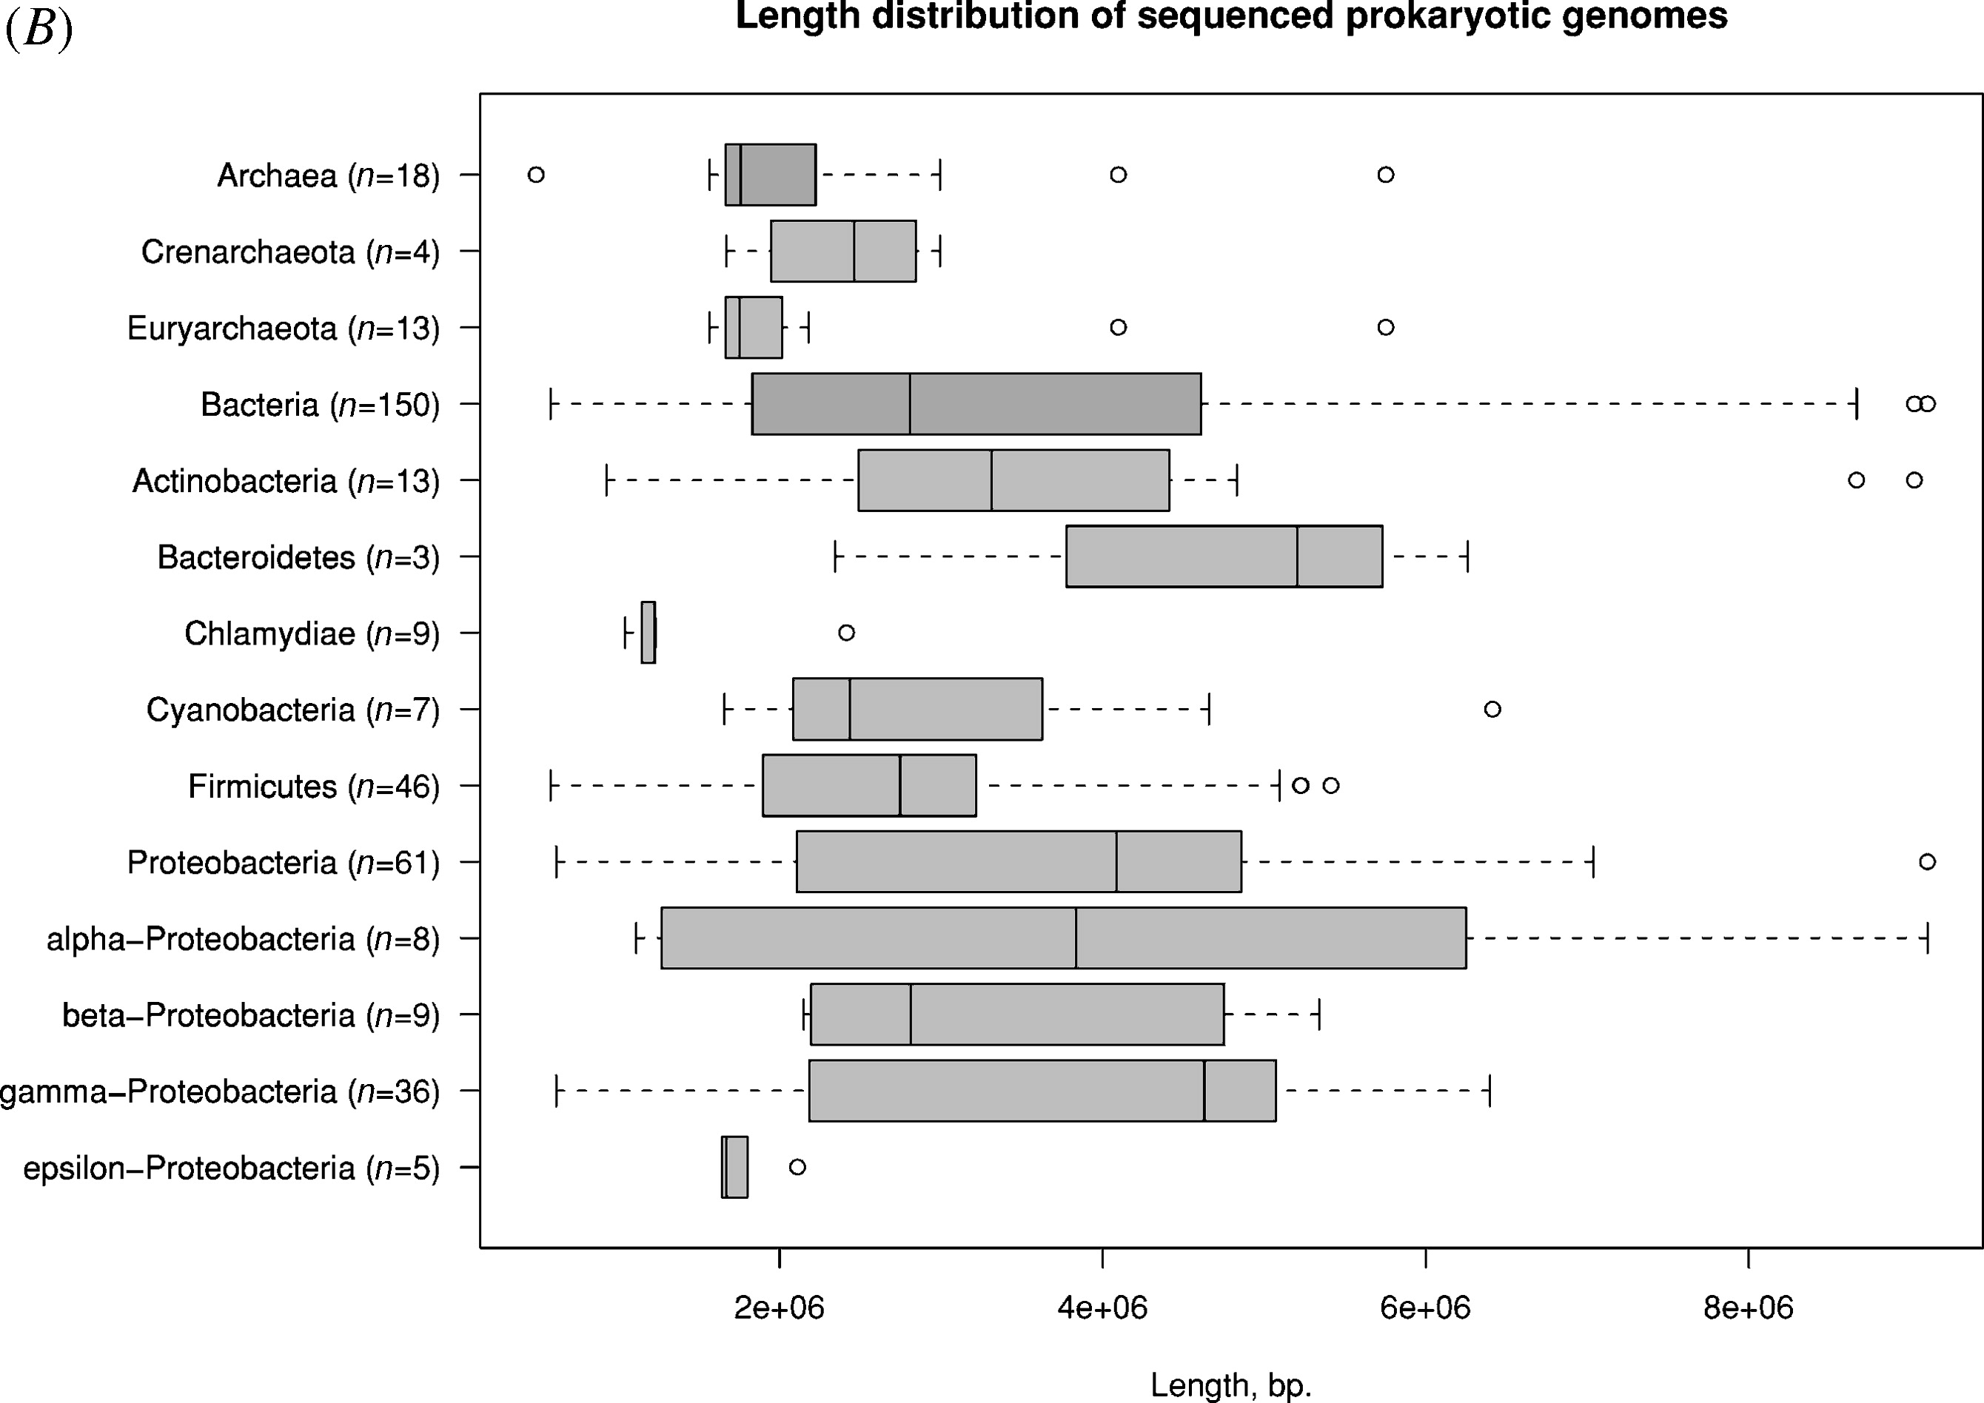
Genome size
Bentley SD, Parkhill J: Comparative genomic structure of
prokaryotes. Annu Rev Genet 2004, 38:771-792.

Slide 5
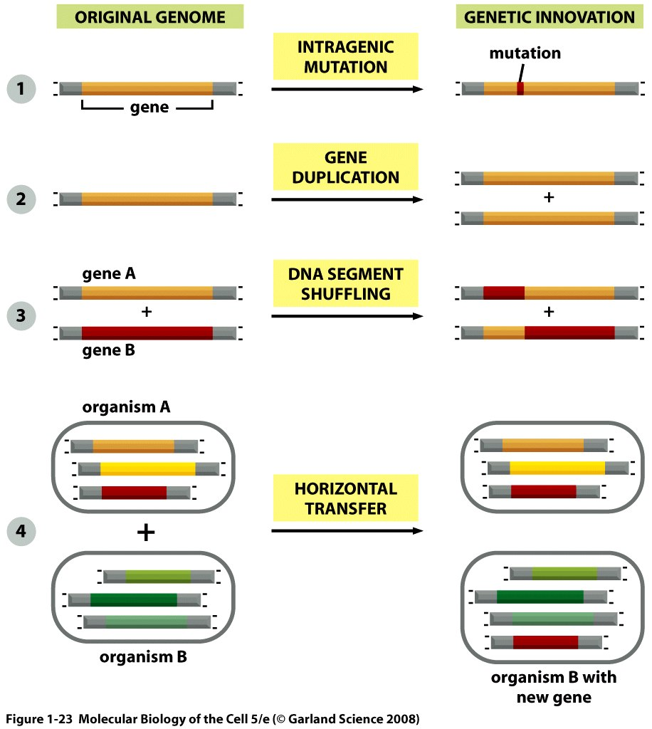
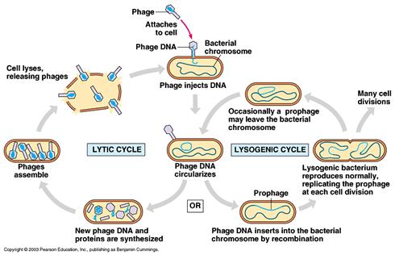
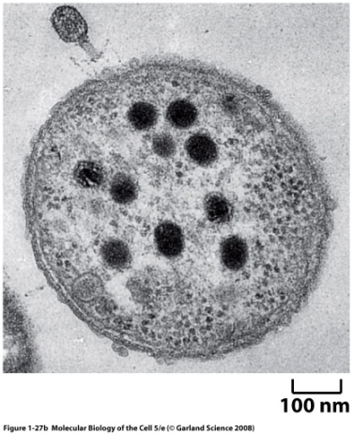
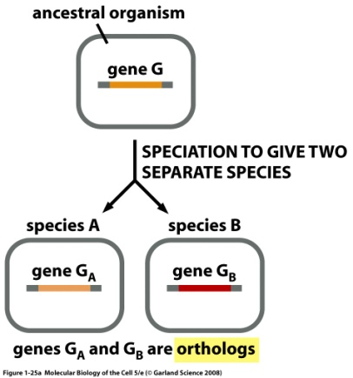
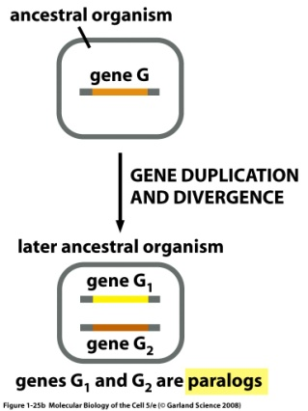
Factors affecting genome size
Intragenic mutation:
Gene duplication:
Segment shuffling:
Horizontal transfer:

Slide 6
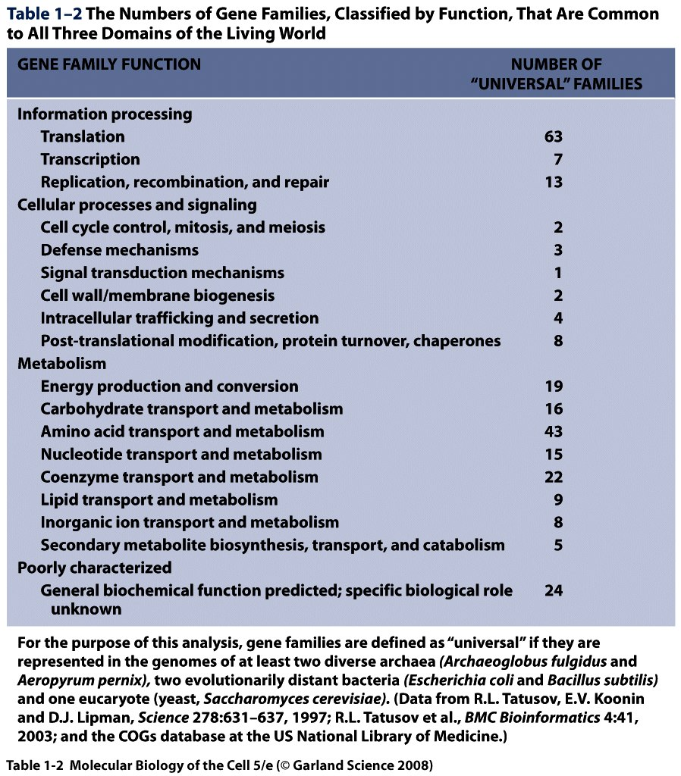
Genes

Slide 7
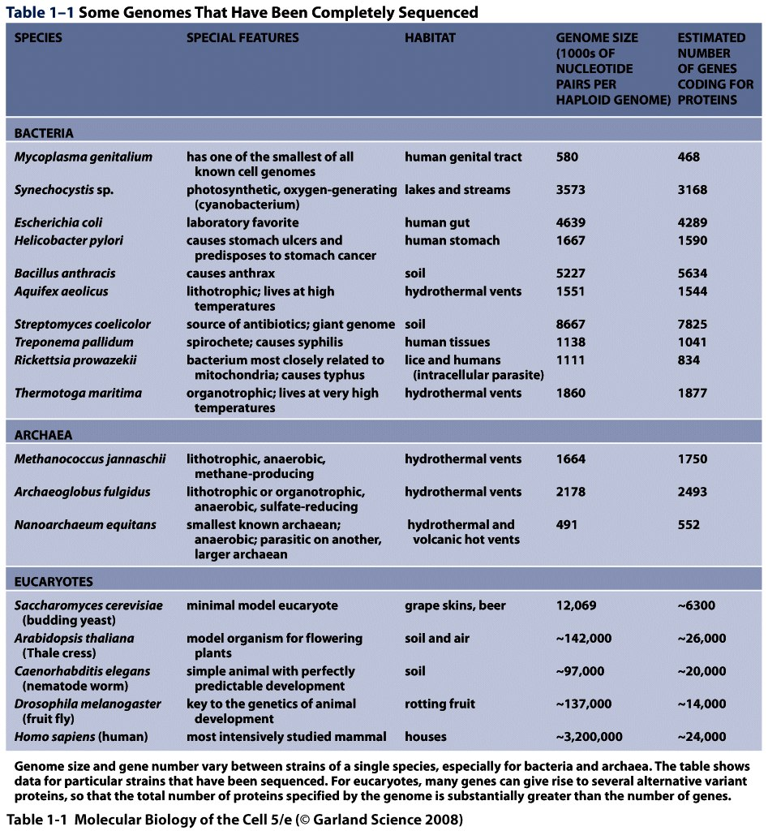
Genome size

Slide 8
Factors affecting genome size
It is thought that there is a correlation between genome size and complexity of environment
The smallest prokaryote genomes tend to belong to organisms restricted to a stable niche, often in association with a host organism
Mycoplasma genitallium
The largest bacterial genomes tend to belong to bacteria that dominate in complex environments such as the soil
Steptomyces coellcolor
Genome size is not always increasing
Adaptation, or response to a simplified or more stable environments
Flagellar apparatus and various of Y. pestis

Slide 9
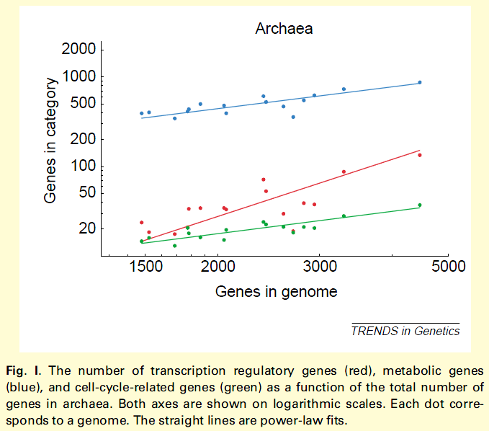
Relationship between genome size and the number of genes in each gene family
n_{c} = λgª, where both λ and the exponent a depend on the category under investigation
van Nimwegen E: Scaling laws in the functional content of genomes. Trends Genet 2003, 19:479-484.

Slide 10
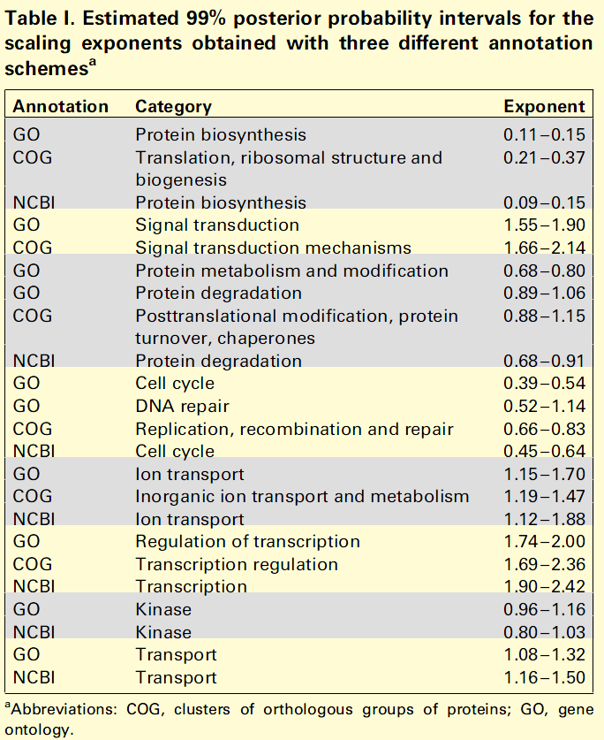
Relationship between genome size and the number of genes in each gene family
Exponent ~= 1
Metabolic genes have exponents close to 1
Exponent > 1
Transcription factors have significantly larger exponent
Exponent < 1
For example, protein biosynthesis related genes have exponent of 0.1
One genome 1 is twenty times as large as another genome 2 of size g,
n_{c1} = λ(20g)ª = 1.35 λgª
n_{c1} = λ(5g)ª = 1.17 λgª
van Nimwegen E: Scaling laws in the functional content of genomes. Trends Genet 2003, 19:479-484.

Slide 11
Classical approaches for estimating genome size – one example
Seawater samples
Seawater was collected at a depth of 15m in the Gulf of Alaska
Samples were preserved with filtered (pore size, 0.2 micro m) formalin (0.5% formaldehyde), stored at 5 °C in the dark
Flow cytometry - counting cells and cell mass (biomass)
Preserved samples were directly stained with DAPI (4’. 6-diamidino-2-phenylindole). DAPI binds to AT content in nucleotides consisting of A,T,G, and C
Measurements were obtained with a modified Ortho Cytofluorograf IIs equipped with a 5-W argon laser
DNA content – the amount of DNA content based on the intensity of fluorescence
DAPI-DNA fluorescence intensity was converted from a logarithmic distribution over 256 channels to 10^3.5 linear channels by Cyclops software
To account for differences in the G+C contents of species due to the AT-binding specificity of DAPI, the DNA content was adjusted to the E. coli standard content
Button DK, Robertson BR: Determination of DNA content of
aquatic bacteria by flow cytometry. Appl Environ Microbiol 2001, 67:1636-1645.

Slide 12
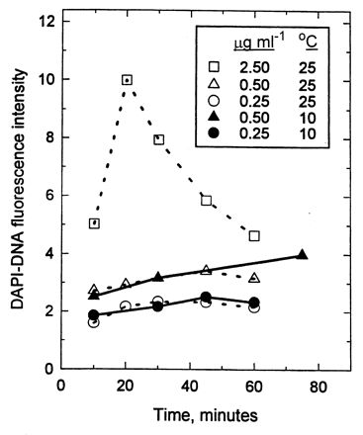
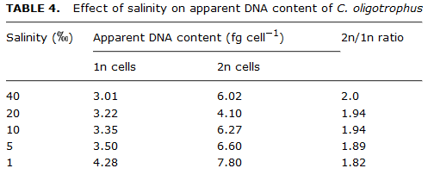
Classical approaches for estimating genome size – two examples for possible errors
Button DK, Robertson BR: Determination of DNA content of
aquatic bacteria by flow cytometry. Appl Environ Microbiol 2001, 67:1636-1645.

Slide 13
Effective genome size (EGS)
Traditional approaches have several problems
the diversity of techniques and parameters used (for example, sample filtering, DNA staining, and cell counting)
Difficulties discriminating between the different ploidy levels of cells
Important biasing factors (GC content, permeability, salinity, influence of debris, and so on)
A novel approach based on raw shotgun sequencing data
Avoid experimental biases such as are mentioned above
When applied to metagenomics data, it measures the average EGS of organisms living

Slide 14
Effective genome size (EGS)
Uses a set of gene markers whose the number of each gene remains constant irrespective of genome size
translation, ribosome structure, and biogenesis
Gene density is defined as the number of marker genes divided by (mega) base pairs examined
The less dense the gene density, the larger genome size, that is, the genome size is inversely proportional to the gene density

Slide 15
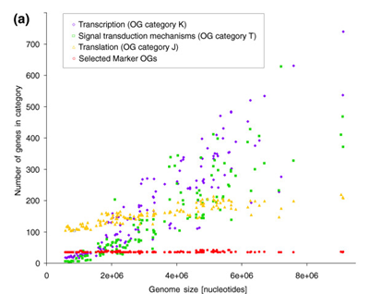
Genome size

Slide 16
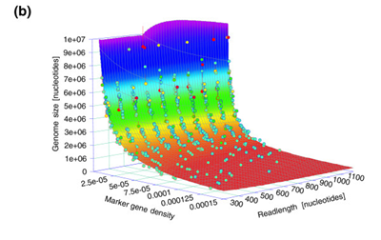
Genome size

Slide 17
Genome size - EGS
Gene density of marker genes is inversely proportional to genome size
Read length also affects genome size inversely
x: gene density
L: read length
This formula is expected to work well since marker genes are equally present in all species

Slide 18
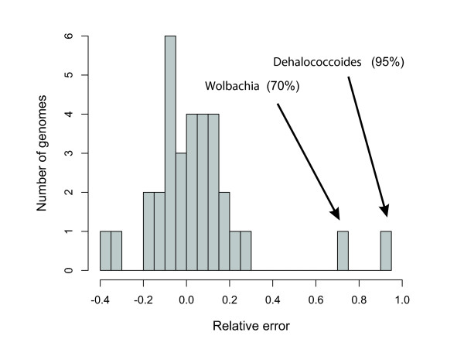
EGS – 32 prokaryotic genomes
Most errors are from
Finite sequencing depth
Uncertainties associated with identification of marker genes using BLAST
Residual biological variation
EGS method gives a way to indicate assembly artifacts or incomplete cloning material

Slide 19
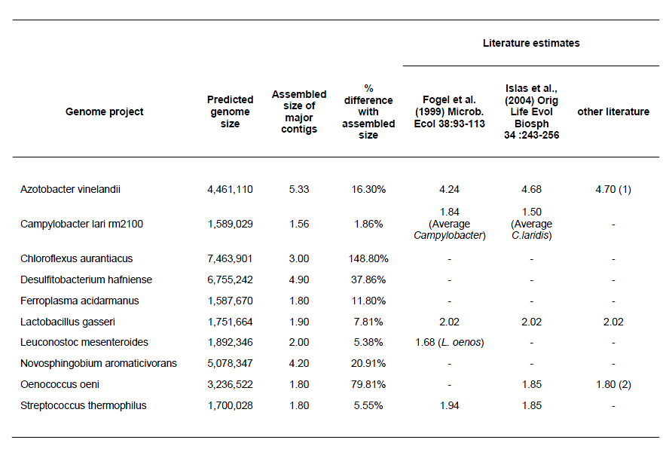
EGS – ongoing genome sequencing projects
Small proportion of eukaryotic DNA present may have a large impact on EGS measurements.

Slide 20
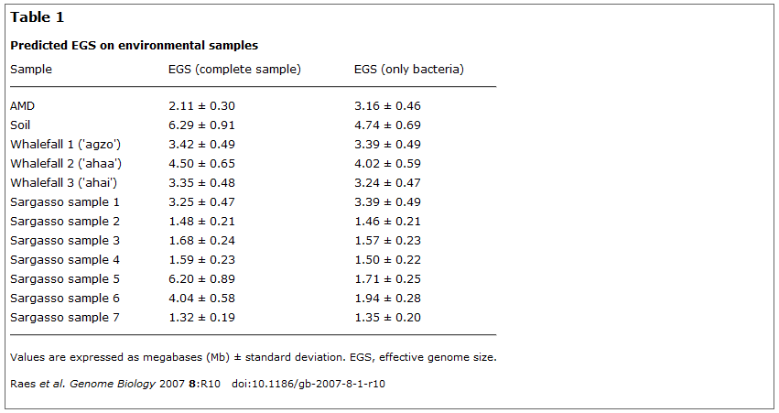
Genome size – 12 environmental samples
Contamination with Shewanella and Burkholderia
Presence of small genome archaea (1.8 Mb)
Eukaryotes presence

Slide 21
Examples for correlation between genome size and environmental complexity
Soil is a very challenging environment
High organism density leads to
Strong competition for nutrients
Complex communication and cooperation strategies
Highly living conditions like seasons and weather
Sargasso sea is relatively simple environment
The EGS of all samples converges to about 1.6 Mb, which is smaller than micro-organisms in soil
Lower organism density

Slide 22
Formula derivation
Based on fully sequenced genomes for calibration
154 previously completely sequenced bacterial and archaeal genomes
50 genomes were randomly chosen per read length bin (300, 400, 500, 600, 700, 800, 900, 1000, 1100, 1200 base pairs)
Reads were sampled until 3x coverage was achieved
Of gene counts based on each read length above, known genome size is related to read length and marker gene density
Expect genome size increases proportionally to the inverse marker gene density 1/x at any given length L: EGS = c(L)/x, where c(L) is a read-length dependent calibration factor
Based on manual comparison of a variety of possible functional forms, c(L) is well approximated by a power law, c(L) = a + b * L^(-c)
The parameters a, b, and c are determined using a nonlinear least-squares

Slide 23
Formula – for a mixture of species
EGS equation can be directly applied to mixtures of genomes, which was confirmed by the simulations
EGS for a mixture of species is defined as the average genome size, for instance,
H1 and H2 are numbers of marked genes in each species, respectively
N1 and N2 are sizes of sequence data in each species, respectively

Slide 24
Conclusion
Genome size (EGS) can be directly determined from raw sequencing reads
EGS suggests a correlation between environmental complexity and the diversity of cellular repertoire
Some genome projects require genome size in advance
For metagenomics sequencing, the average genome size
Allows to calculate the amount of sequencing data necessary
For DNA reassociation kinetics
Helps understand ecosystem species composition and biodiversity
Require knowledge of the average genome size to translate genetic diversity into species diversity
However, EGS is limited to predicting only the average EGS of a given community
Improvements in phylogenetic separation of metagenomic sequences should allow EGS to predict genome distributions in the future

Slide 25
Thank you

