Slide 1
Large-Scale Sequencing of the Influenza Virus Genome
Steven Salzberg
Center for Bioinformatics and Computational Biology
University of Maryland Institute for Advanced Computer Studies (UMIACS)
CMSC 828H, November 2010

Slide 2
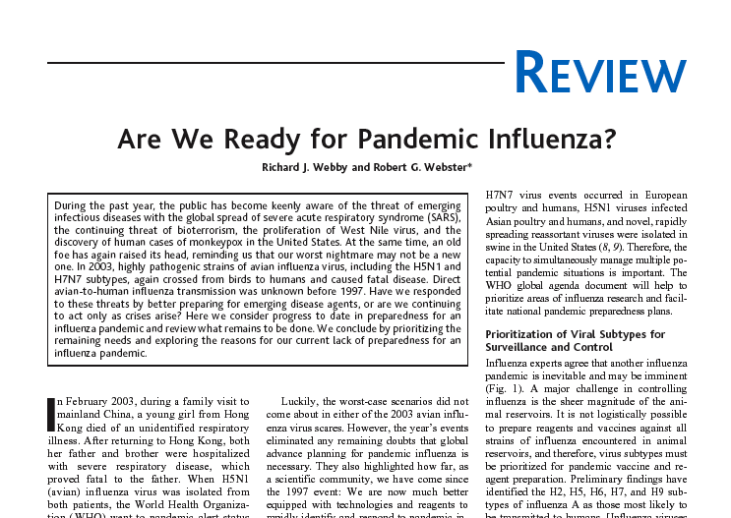
Science, 28 November 2003

Slide 3
Dominant influenza strains
Current human influenza A: strains H3N2 and H1N1
Avian influenza A: strain H5N1
1918 “Spanish flu”: H1N1
Originally an avian virus
Killed 30-50 million (est.) in 4 years
Deaths were reported to occur within 24 hours
One-fifth of the world’s population infected
Estimated 43,000 U.S. soldiers in WWI died of influenza
1889 and 1957 pandemics: H2N2
1968 “Hong Kong” pandemic: H3N2
1977 “Russian” outbreak: H1N1
2009 “Swine flu”: H1N1

Slide 4
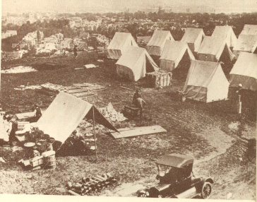
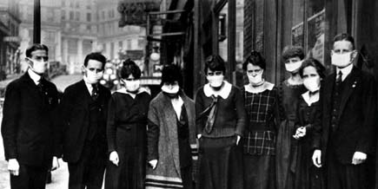
1918 Spanish flu
Impact so severe that average U.S. life span decreased 10 years
28% of U.S. population infected
Mortality rate estimated at 2.5% (versus <0.1% for most flu strains)

Slide 5
Influenza crossing the species barrier
Asia Bird Flu Kills 8, Spreads to China
By TED ANTHONY
The Associated Press
Tuesday, January 27, 2004
BEIJING - China confirmed bird flu Tuesday in at least one duck and
said it was investigating "suspect" cases of other dead poultry, an
announcement that opened a potentially fearsome new front in the
fight against the virus - the world's most populous country.
Bird flu has now appeared in 10 Asian nations.

Slide 6
Why do a flu genome project?
Vaccine formulation, i.e. predicting dominant strain
Antigenic drift:
Accumulation of nonsynonymous changes at sites of immunologic pressure; mainly functions on surface proteins HA & NA
Antigenic shift:
Reassortant event between two different influenza A strains, especially involving replacement of surface glycoprotein-encoding gene segments

Slide 7
Research questions
Study genotypic correlates of virulence
Study frequency of genetic re-assortment
good background data non-existent
Estimate evolutionary rate in different hosts
Where do pandemic strains adapt to human host?
Avian flu – how diverse?
How does genetic material move around among wild and domestic birds?

Slide 8
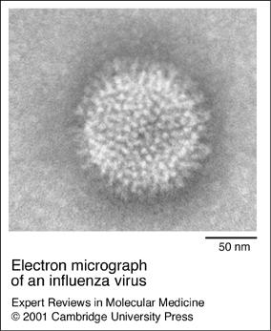
Flu genome
RNA virus
Viral particles contain 8 “segments”
Particles 100-200 nm
Photo credits: G.R. Whitaker (above), L. Stannards (left)

Slide 9
Credit: Paul Digard, Univ. of Cambridge

Slide 10
Flu replication
Credit: Paul Digard, Univ. of Cambridge

Slide 11
Paucity of Public Sequence Data
As of 2004, 50 complete HA segments (H3N2)
For HA1 in 2003, 19 H3N2 (> half from S. Africa)
2002, 11 H3N2, 12 H1N2, 37 H1N1 (mostly from Japan & Korea)
For NA in 2003, none!
Other segments have only a handful/year
Until 2005, only 7 complete H3N2 genomes
Avian flu has 54 complete genomes but 41/54 from Hong Kong markets
Basically, we don’t know what’s out there

Slide 12
Influenza genome sequencing project
White paper proposal (Dec 2003)
submitted by David Lipman, Steven Salzberg, et al
approved by NIAID January 2004
Preliminary Testing (Mar – Aug 2004)
Protocol testing (micro-libraries, random priming, directed walking) led by Elodie Ghedin at TIGR
Laboratory set-up
PHASE I: R&D (Sept 2004 – Aug 2005)
Optimize methodologies
Develop high-throughput pipeline
Process 500 Wadsworth samples
PHASE II: High-throughput (Mar 2005 – present)
Develop capacity for 400 samples/month
Process >3000 samples/year
PHASE III: Begin avian flu sequencing (Aug 2005)

Slide 13
Reverse transcription (RT) and amplification (PCR) generates redundant coverage
Protocol v.5: 1 sample per 96-well plate
4-6X coverage
Segment 2
PB1

Slide 14
Original Plate Format One Sample per 96-well Plate
Yellow = end sequences
Red = QC

Slide 15
Genome Assembly
8 assemblies per sample
Each segment is assembled separately as a tiling of sequenced amplicons.
Amplicon sequencing covering ligated ends handled specially
Multiple alignment + consensus is only a small part of total process
PB1
Segment
4-6x coverage
Reference
substrate
segment endpoint

Slide 16
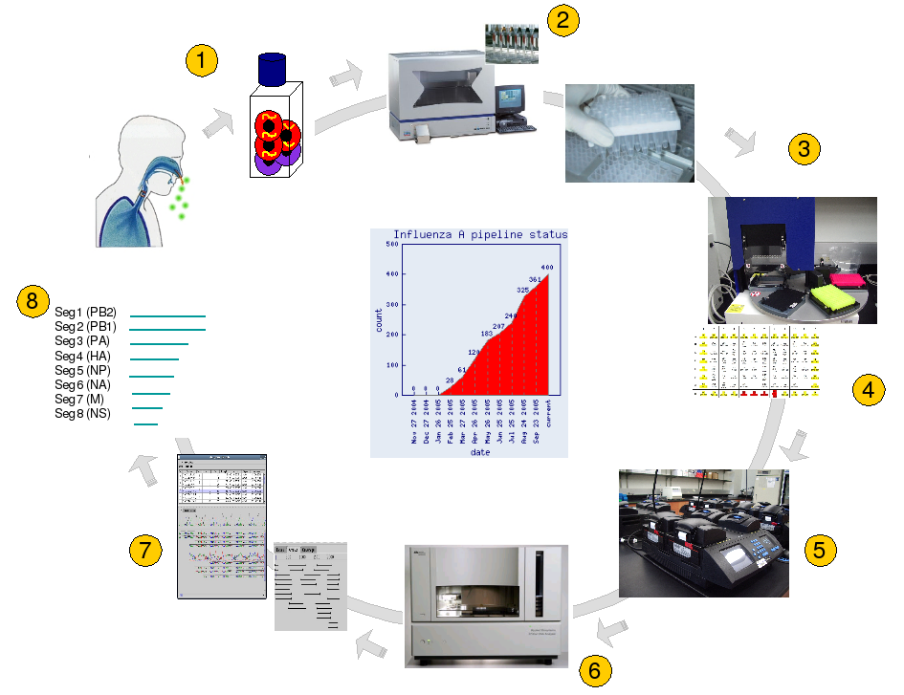
TIGR high-throughput pipeline
Notes:
1. Sample collection and amplification by cell culture
2. Extraction of virus genomic RNA from cell culture supernatants (48 samples at a time)
3. RNA shipped to TIGR and processed in 96-well plate format
4. Primer design
5. Amplification by RT-PCR of overlapping regions of each virus segment (1 virus isolate per 96-well plate; 4 plates per thermocycler)
6. Sequencing of PCR amplicons using M13-universal primers in 384-well plate formats (4 virus isolates sequenced simultaneously)
7. Trimming of sequences, assembly of segments, editing of nucleotides
8. quality assurance and submission to NCBI

Slide 17
Processing Throughput: 100 samples/week

Slide 18
PRIMARY
PIPELINE
4-5 days
SECONDARY
PIPELINE
2-4 days
RT-PCR
Failed sequences
Sequencing
Re-sequence
Success
Fail
1st Assembly
RT-PCR
AutoEditing
Manual editing
Validated!
Submission
Sequence
Success
Both seqs fail
ambiguities
Re-design
primers
2nd Assembly
Special
Closure
Bin
Manual editing
Validated!
Submission
ambiguities

Slide 19
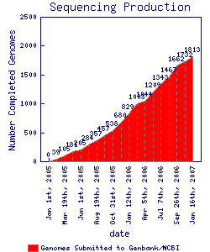
Influenza Genome Sequencing Project, January 2005 - 2007
March 2007:
2000 complete genomes
March 2008:
3000 complete genomes

Slide 20
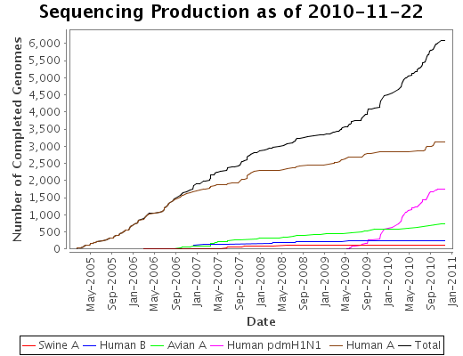
Influenza Genome Sequencing Project, 2005 - 2010

Slide 21
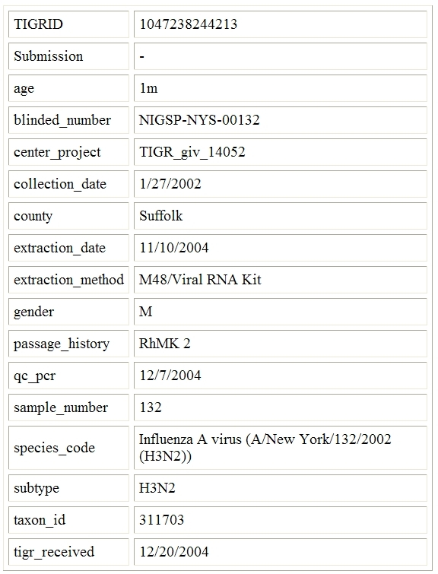

Slide 22
Influenza assemblies are available at NCBI Assembly Archive

Slide 23
Phylogenetic analysis of the first 156 isolates

Slide 24
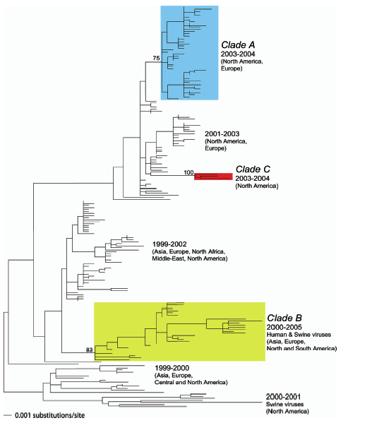
197 NA segments from NYS and other sites worldwide, 1999-2005

Slide 25
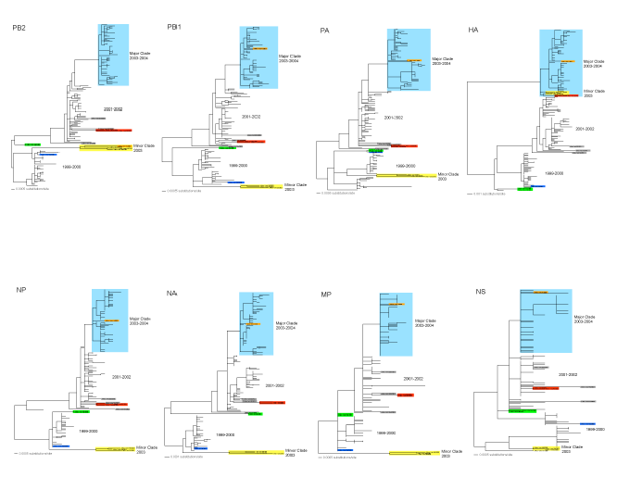
H3N2 Analysis

Slide 26
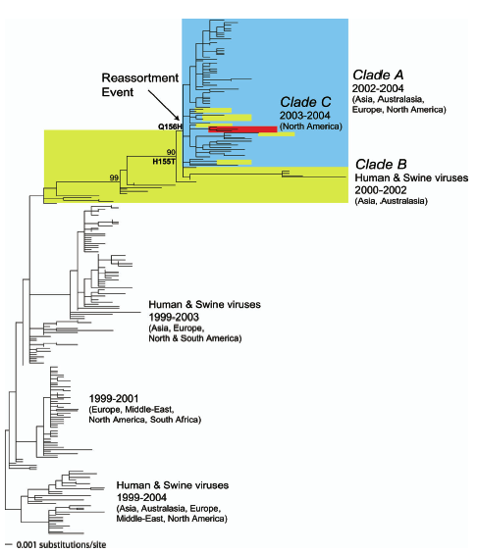
Re-assortment event in 2002: “Fujian” strain acquired HA from minor clade

Slide 27
Antigenic shift event, 2002-2003
H3N2 Clade A(2001-3)
H3N2 Clade B (1999-)
Seg1 (PB2)
Seg2 (PB1)
Seg3 (PA)
Seg4 (HA)
Seg5 (NP)
Seg6 (NA)
Seg7 (M)
Seg8 (NS)
Seg1 (PB2)
Seg2 (PB1)
Seg3 (PA)
Seg4 (HA)
Seg5 (NP)
Seg6 (NA)
Seg7 (M)
Seg8 (NS)
H3N2 dominant strain (2003-)
Seg1 (PB2)
Seg2 (PB1)
Seg3 (PA)
Seg4 (HA)
Seg5 (NP)
Seg6 (NA)
Seg7 (M)
Seg8 (NS)

Slide 28
What Happened?
Minor variant (Clade B) diverged genetically for several years but not antigenically as measured by HI test (changes did affect egg growth)
In some sense, less fit than Clade A
In 2002/2003 season, HA position 155 mutated, with antigenic consequences
H->T requires additional prior replacement, so this was 2nd change
Followed by Q -> H in position 156 with major antigenic impact, creating Fujian HA
HH was not stable in experiments, so position 155 had to mutate from H->T first
Fujian HA spread by reassortment to all other H3N2 strains
Why not initially dominant?
Initial 2003-2004 dominant strain was reassortant
Later 2003-2004 and 2005 dominant strain was Clade B
What changed in Clade B?

Slide 29
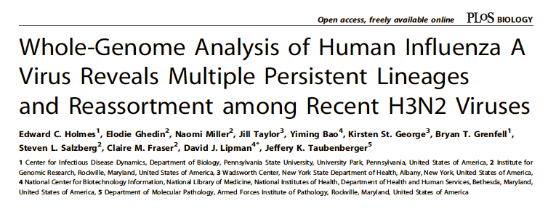
PLoS Biol 3(9), e300 (July 2005)

Slide 30
Genome-wide mutational analysis across five seasons

Slide 31
Correlated mutations - possible co-mutations

Slide 32
What does it look like with 500 genomes?
- including New Zealand
2004-5
isolates
Clade B
Reassortants
NA

Slide 33
Nature, 20 October 2005,1162-66.

Slide 34
Flu collections sequenced by the TIGR project
New Zealand human
Australia human
St. Jude’s (R. Webster) historical human, swine, equine
Ohio State (R. Slemens) avian
NIH historical human
Italy (Ilaria Capua) - avian H5N1, highly pathogenic, current outbreak

Slide 35
Data release still a major issue
Most flu labs still don’t release samples or sequences
Traditionally there was no urgency to release data
Scientists - in the US and abroad - are concerned about “credit”
Data release not required by funders (yet)

Slide 36
The 2009 Pandemic

