Slide 1
De Bruijn graph assembly
slides by Michael C. Schatz
(with exceptions where noted)

Slide 2
Shredded Book Reconstruction
Dickens accidentally shreds the first printing of A Tale of Two Cities
Text printed on 5 long spools
It was the best of
times, it was the worst
of times, it was the
age of wisdom, it was
the age of foolishness, …
It was the best of
It was the best of times, it was the worst of times, it was the age of wisdom, it was the age of foolishness, …
times, it was the worst
of times, it was the
age of wisdom, it was
the age of foolishness, …
It was the best
of times, it was the
worst of times, it was
the age of wisdom, it
was the age of foolishness,
It was the best
of times, it was the
worst of times, it was
the age of wisdom, it
was the age of foolishness,
It was the best of times, it was the worst of times, it was the age of wisdom, it was the age of foolishness, …
It was the
best of times, it was
the worst of times, it
was the age of wisdom,
it was the age of
foolishness, …
It was the
best of times, it was
the worst of times, it
was the age of wisdom,
it was the age of
foolishness, …
It was the best of times, it was the worst of times, it was the age of wisdom, it was the age of foolishness, …
It was
the best of times, it
was the worst of times,
it was the age of
wisdom, it was the age
of foolishness, …
It was
the best of times, it
was the worst of times,
it was the age of
wisdom, it was the age
of foolishness, …
It was the best of times, it was the worst of times, it was the age of wisdom, it was the age of foolishness, …
It
was the best of times,
It was the best of times, it was the worst of times, it was the age of wisdom, it was the age of foolishness, …
It
was the best of times,
it was the worst of
times, it was the age
of wisdom, it was the
age of foolishness, …
it was the worst of
times, it was the age
of wisdom, it was the
age of foolishness, …
How can he reconstruct the text?
5 copies x 138, 656 words / 5 words per fragment = 138k fragments
The short fragments from every copy are mixed together
Some fragments are identical
Notes:
Fragment are very short compared to the length of the text
~5 words per fragment uniformly sampling the text
Fragment boundaries from different spools occur at different positions
Compare fragments to each other to find overlapping sequences

Slide 3
Greedy Reconstruction
It was the best of
age of wisdom, it was
best of times, it was
it was the age of
it was the age of
It was the best of
it was the worst of
was the best of times,
of times, it was the
the best of times, it
of times, it was the
best of times, it was
of wisdom, it was the
of times, it was the
the age of wisdom, it
of times, it was the
the best of times, it
times, it was the worst
the worst of times, it
times, it was the age
times, it was the age
times, it was the worst
The repeated sequence make the correct reconstruction ambiguous
It was the best of times, it was the [worst/age]
Model sequence reconstruction as a graph problem.
was the age of wisdom,
was the age of foolishness,
was the best of times,
was the worst of times,
wisdom, it was the age
worst of times, it was

Slide 4
de Bruijn Graph Construction
D_{k} = (V,E)
V = All length-k subfragments
E = Directed edges between consecutive subfragments
Nodes overlap by k-1 words
Locally constructed graph reveals the global sequence structure
Overlaps between sequences implicitly computed
Original Fragment
Directed Edge
It was the best of
It was the best
was the best of
de Bruijn, 1946
Idury and Waterman, 1995
Pevzner, Tang, Waterman, 2001

Slide 5
No need to compute overlaps!
Can this really work?
How do we choose a value for k?
Needs to be big enough to be unique
But repeats make it impossible to use such a large k, because entire reads are not unique
So pick k to be “big enough”

Slide 6
de Bruijn Graph Assembly
It was the best
was the best of
the best of times,
it was the worst
best of times, it
was the worst of
of times, it was
the worst of times,
times, it was the
worst of times, it
A unique Eulerian tour of the graph reconstructs the original text
If a unique tour does not exist, try to simplify the graph as much as possible
it was the age
the age of foolishness
was the age of
the age of wisdom,
age of wisdom, it
of wisdom, it was
wisdom, it was the

Slide 7
de Bruijn Graph Assembly
It was the best of times, it
it was the worst of times, it
of times, it was the
the age of foolishness
A unique Eulerian tour of the graph reconstructs the original text
If a unique tour does not exist, try to simplify the graph as much as possible
it was the age of
the age of wisdom, it was the

Slide 8
Origin of the Euler tour idea: Sequencing by hybridization
J Biomol Struct Dyn. 1989 Aug;7(1):63-73.
1-Tuple DNA sequencing: computer analysis.
Pevzner PA.
Laboratory of Mathematical Methods Institute of Genetics of Microorganisms, Moscow, USSR.
Abstract
A new method of DNA reading was proposed at the end of 1988 by Lysov et al. According to the authors' claims it has certain advantages as compared to the Maxam-Gilbert and Sanger methods, which are revealed by automation and rapidity of DNA sequencing. Nevertheless its employment is hampered by a number of biological and mathematical problems. The present study proposes an algorithm that allows to overcome the computational difficulties occurring in the course of the method during reconstruction of the DNA sequence by its l-tuple composition. It is shown also that the biochemical problems connected with the loss of information about the l-tuple DNA composition during hybridization are not crucial and can be overcome by finding the maximal flow of minimal cost in the special graph.

Slide 9
Strategy: find all k-mers, build graph
Every k-mer becomes a node
Two nodes are linked with an edge if they share a k-1 mer
GACTGGGACTCC
GACTGG
ACTGGG
CTGGGA
TGGGAC
GACTCC
GGACTC
GGGACT

Slide 10
Graph size (de Bruijn graph)
One node per k-mer
Overall size limited by genome size G
But if k is small, then
graph size should limited by 4^{k}
Question: is this really true?
what about sequencing errors?

Slide 11
Counting Eulerian Tours
B
ARBRCRD
or
ARCRBRD
A
R
D
C
Generally an exponential number of compatible sequences
Value computed by application of the BEST theorem (Hutchinson, 1975)
L = n x n matrix with r_{u}-a_{uu} along the diagonal and -a_{uv} in entry uv
r_{u} = d⁺(u)+1 if u=t, or d⁺(u) otherwise
a_{uv} = multiplicity of edge from u to v
Assembly Complexity of Prokaryotic Genomes using Short Reads.
Kingsford C, Schatz MC, Pop M (2010) BMC Bioinformatics.

Slide 12
Short Read Assembly
Reads
de Bruijn Graph
Potential Genomes
AAGA
ACTT
ACTC
ACTG
AGAG
CCGA
CGAC
CTCC
CTGG
CTTT
…
CCG
TCC
AAGACTCCGACTGGGACTTT
AAGACTGGGACTCCGACTTT
CGA
CTC
AAG
AGA
GAC
ACT
CTT
TTT
GGA
CTG
GGG
TGG
Genome assembly as finding an Eulerian tour of the de Bruijn graph
Human genome: >3B nodes, >10B edges
The new short read assemblers require tremendous computation
Velvet (Zerbino & Birney, 2008) serial: > 2TB of RAM
ABySS (Simpson et al., 2009) MPI: 168 cores x ~96 hours
SOAPdenovo (Li et al., 2010) pthreads: 40 cores x 40 hours, >140 GB RAM

Slide 13
Graph Compression
AAGA
ACTT
ACTC
ACTG
AGAG
CCGA
CGAC
CTCC
CTGG
CTTT
…
CCG
TCC
CGA
CTC
AAG
AGA
GAC
ACT
CTT
TTT
GGA
CTG
GGG
TGG
CCGA
CTCC
CTCCGA
AAGA
GACT
CTTT
AAGA
GACT
CTTT
GGGA
CTGG
CTGGGA

Slide 14
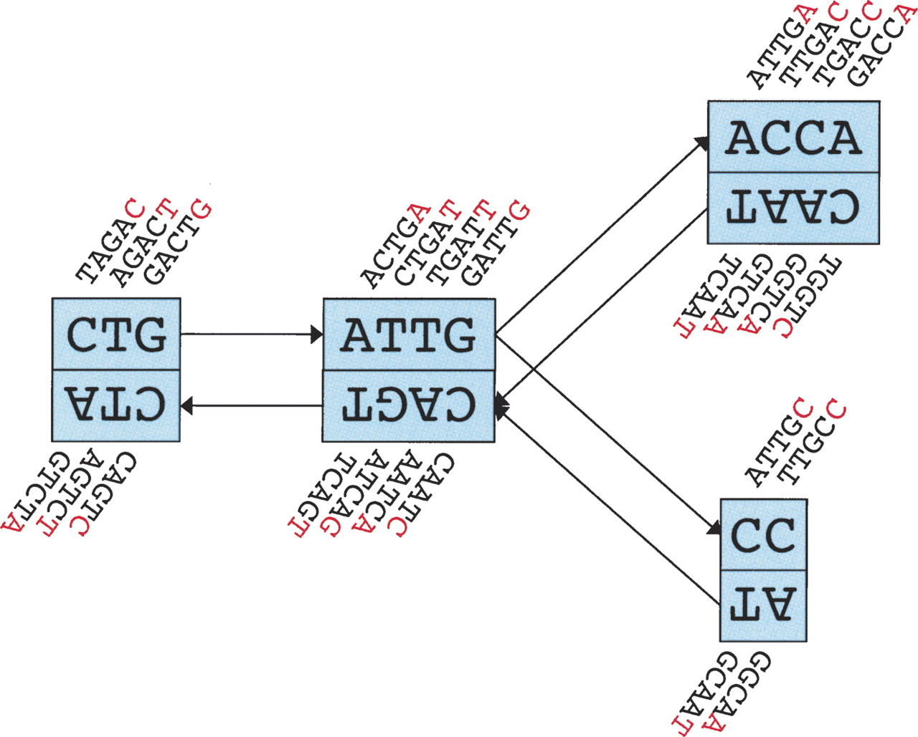
Schematic representation of our implementation of the de Bruijn graph.
Schematic representation of our implementation of the de Bruijn graph. Each node, represented by a single rectangle, represents a series of overlapping k-mers (in this case, k = 5), listed directly above or below. (Red) The last nucleotide of each k-mer. The sequence of those final nucleotides, copied in large letters in the rectangle, is the sequence of the node. The twin node, directly attached to the node, either below or above, represents the reverse series of reverse complement k-mers. Arcs are represented as arrows between nodes. The last k-mer of an arc’s origin overlaps with the first of its destination. Each arc has a symmetric arc. Note that the two nodes on the left could be merged into one without loss of information, because they form a chain.
Zerbino D R , Birney E. Velvet: Algorithms for de novo short read assembly using de Bruijn graphs. Genome Res. 2008;18:821-829
©2008 by Cold Spring Harbor Laboratory Press
Notes:
Schematic representation of our implementation of the de Bruijn graph. Each node, represented by a single rectangle, represents a series of overlapping k-mers (in this case, k = 5), listed directly above or below. (Red) The last nucleotide of each k-mer. The sequence of those final nucleotides, copied in large letters in the rectangle, is the sequence of the node. The twin node, directly attached to the node, either below or above, represents the reverse series of reverse complement k-mers. Arcs are represented as arrows between nodes. The last k-mer of an arc’s origin overlaps with the first of its destination. Each arc has a symmetric arc. Note that the two nodes on the left could be merged into one without loss of information, because they form a chain.

Slide 15
Bidirectional de Bruijn Graph
Designate a representative mer for each mer/rc(mer) pair
Use the lexigraphically smaller mer
Bidirected edges record if connection is between forward or reverse mer
In practice, keep separate adjacency lists for the forward and reverse mers
AAGG [CCTT]: AAG⁺ -> AGG⁺
ACTT [AAGA]: ACT⁺ -> AAG⁻
GCTT [AAGC]: AGC⁻ -> AAG⁻
AAG⁺ -> AGC⁺
AGG
CCT
ACT
AAG
AGT
CTT
AGC
GCT
(Medvedev et al, 2007)

Slide 16
Graph Compression
After construction, many edges are unambiguous
Merge together compressible nodes
Graph physically distributed over hundreds of computers (in Contrail)
Notes:
Compression must work using just local information
Adjacent nodes are potentially stored on different nodes
Maintain global consistency

Slide 17
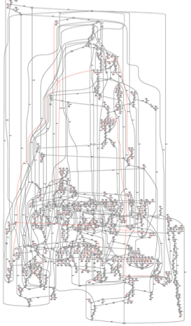
Node Types
Isolated nodes (10%)
Tips (46%)
Bubbles/Non-branch (9%)
Dead Ends (.2%)
Half Branch (25%)
Full Branch (10%)
(Chaisson, 2009)

Slide 18
Error Correction
Errors at end of read
Trim off ‘dead-end’ tips
Errors in middle of read
Pop Bubbles
Chimeric Edges
Clip short, low coverage nodes
B’
A
A
B
B
B’
A
C
A
B*
C
B
A
B
A
B
x
C
D
C
D
Notes:
After correction, more opportunities for path compression
Hard to distinguish errors from repeats -> coverage can indicate

Slide 19
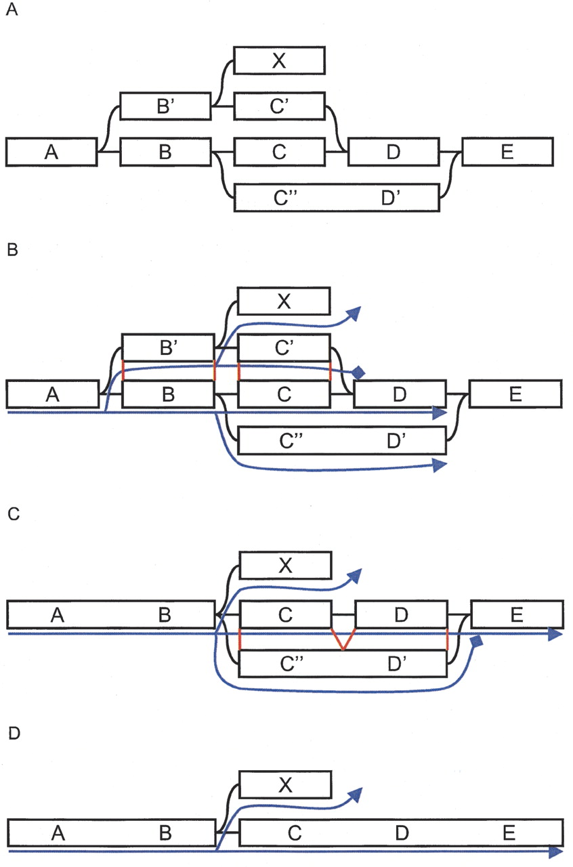
Example of Tour Bus error correction in Velvet.
Example of Tour Bus error correction. (A) Original graph. (B) The search starts from A and spreads toward the right. The progression of the top path (through B′ and C′) is stopped because D was previously visited. The nucleotide sequences corresponding to the alternate paths B′C′ and BC are extracted from the graph, aligned, and compared. (C) The two paths are judged similar, so the longer one, B′C′, is merged into the shorter one, BC. The merging is directed by the alignment of the consensus sequences, indicated in red lines in B. Note that node X, which was connected to node B′, is now connected to node B. The search progresses, and the bottom path (through C′ and D′) arrives second in E. Once again, the corresponding paths, C′D′ and CD are compared. (D) CD and C′D′ are judged similar enough. The longer path is merged into the shorter one.
Zerbino D R , Birney E Genome Res. 2008;18:821-829
Notes:
Example of Tour Bus error correction. (A) Original graph. (B) The search starts from A and spreads toward the right. The progression of the top path (through B′ and C′) is stopped because D was previously visited. The nucleotide sequences corresponding to the alternate paths B′C′ and BC are extracted from the graph, aligned, and compared. (C) The two paths are judged similar, so the longer one, B′C′, is merged into the shorter one, BC. The merging is directed by the alignment of the consensus sequences, indicated in red lines in B. Note that node X, which was connected to node B′, is now connected to node B. The search progresses, and the bottom path (through C′ and D′) arrives second in E. Once again, the corresponding paths, C′D′ and CD are compared. (D) CD and C′D′ are judged similar enough. The longer path is merged into the shorter one.

Slide 20
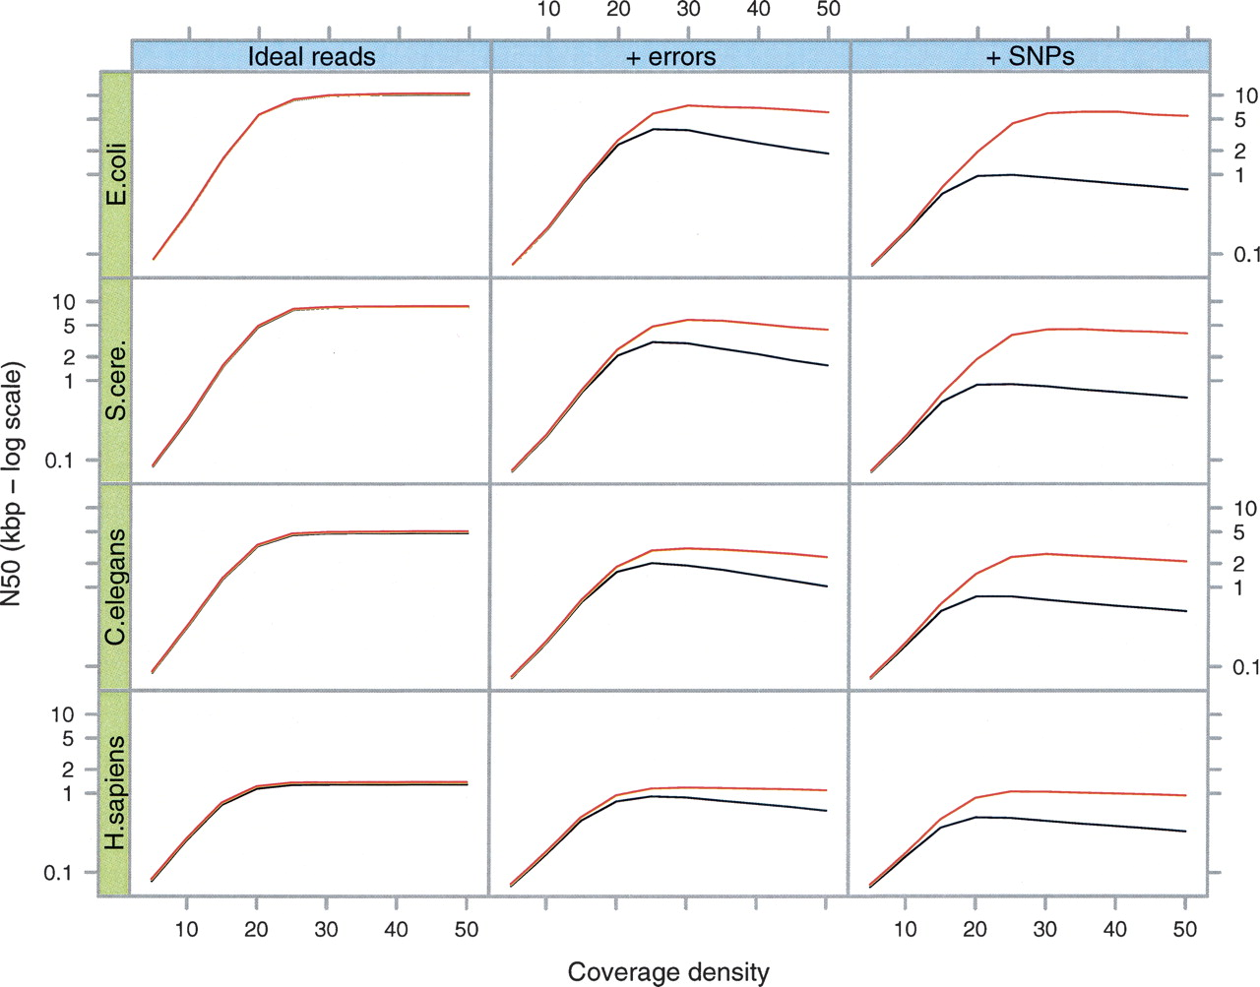
Simulations of Tour Bus in Velvet using 35 bp reads
Blue curve: after tip clipping
Red curve: after bubble smoothing
Errors at 1%, SNPs at 1/500
Zerbino D R , Birney E Genome Res. 2008;18:821-829
Notes:
Simulations of Tour Bus. The genome of E. coli and 5-Mb samples of DNA from three other species (S. cerevisiae, C. elegans, and H. sapiens, respectively) were used to generate 35-bp read sets of varying read depths (X-axis of each plot). We measured the contig length N50 (Y-axis, log scale) after tip-clipping (black curve) then after the subsequent bubble smoothing (red curve). In the first column are the results for perfect, error-free reads. In the second column, we inserted errors in the reads at a rate of 1%. In the third column, we generated a slightly variant genome from the original by inserting random SNPs at a rate of 1 in 500. The reads were then generated with errors from both variants, thus simulating a diploid assembly.

Slide 21
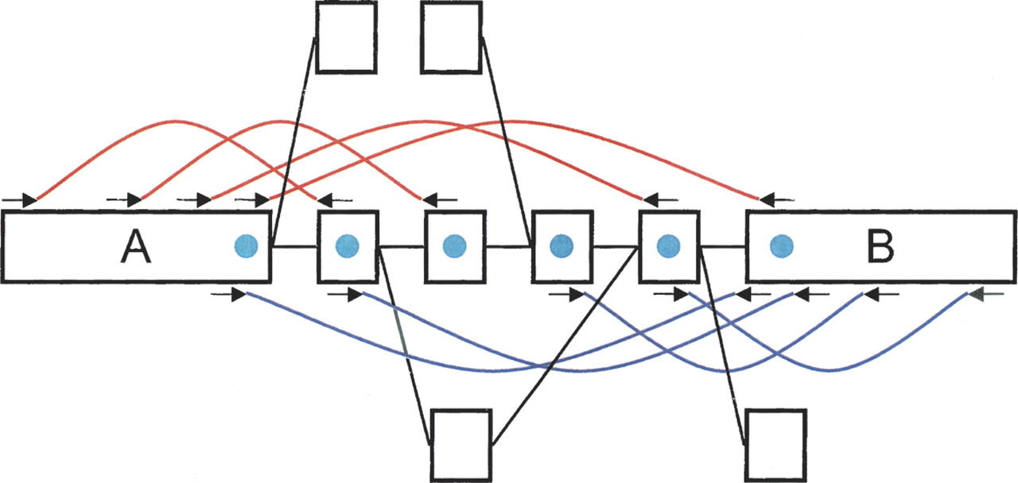
The Breadcrumb algorithm in Velvet
Breadcrumb algorithm. Two long contigs produced after error correction, A and B, are joined by several paired reads (red and blue arcs). The path between the two can be broken up because of a repeat internal to the connecting sequence, because of an overlap with a distinct part of the genome, or because of some unresolved errors. The small square nodes represent either nodes of the path between A and B, or other nodes of the graph connected to the former. Finding the exact path in the graph from A to B is not straightforward because of all the alternate paths that need to be explored. However, if we mark all the nodes that are paired up to either A or B (with a blue circle), we can define a subgraph much simpler to explore. Ideally, only a linear path connects both nodes.
©2008 by Cold Spring Harbor Laboratory Press
Zerbino D R , Birney E Genome Res. 2008;18:821-829
Notes:
Breadcrumb algorithm. Two long contigs produced after error correction, A and B, are joined by several paired reads (red and blue arcs). The path between the two can be broken up because of a repeat internal to the connecting sequence, because of an overlap with a distinct part of the genome, or because of some unresolved errors. The small square nodes represent either nodes of the path between A and B, or other nodes of the graph connected to the former. Finding the exact path in the graph from A to B is not straightforward because of all the alternate paths that need to be explored. However, if we mark all the nodes that are paired up to either A or B (with a blue circle), we can define a subgraph much simpler to explore. Ideally, only a linear path connects both nodes.

Slide 22
Repeat Analysis in Contrail
X-cut
Annotate edges with spanning reads
Separate fully spanned nodes
(Pevzner et al., 2001)
Scaffolding
If mate pairs are available search for a path consistent with mate distance
Use message passing to iteratively collect linked and neighboring nodes
A
B
A
R
B
R
C
D
C
R
D
B
A
R
D
A
R
B
R
C
R
D
C
Parallel Frontier Search

Slide 23
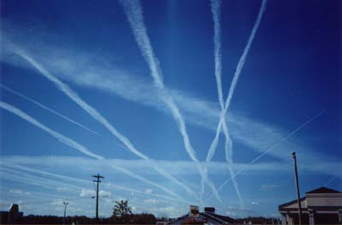
Contrail
http://contrail-bio.sourceforge.net
Scalable Genome Assembly with MapReduce
Genome: E. coli K12 MG1655, 4.6Mbp
Input: 20.8M 36bp reads, 200bp insert (~150x coverage)
Preprocessor: Quality-Aware Error Correction
Initial
Compressed
Error Correction
Resolve Repeats
Cloud Surfing
N
Max
N50
5.1 M
27 bp
27 bp
245,131
1,079 bp
156 bp
2,769
70,725 bp
15,023 bp
1,909
90,088 bp
20,062 bp
300
149,006 bp
54,807 bp
Assembly of Large Genomes with Cloud Computing.
Schatz MC, Sommer D, Kelley D, Pop M, et al. In Preparation.
Notes:
Velvet 54,359

Slide 24
Contrail
http://contrail-bio.sourceforge.net
De Novo Assembly of the Human Genome
Genome: African male NA18507 (SRA000271, Bentley et al., 2008)
Input: 3.5B 36bp reads, 210bp insert (~40x coverage)
Initial
Compressed
Clip Tips
Pop Bubbles
Chimeric Edges
B’
B’
A
B
A
A
C
x
B
B
C
D
N
Max
N50
>7 B
27 bp
27 bp
>1 B
303 bp
< 100 bp
5.0 M
14,007 bp
650 bp
4.2 M
20,594 bp
923 bp
In progress
Assembly of Large Genomes with Cloud Computing.
Schatz MC, Sommer D, Kelley D, Pop M, et al. In Preparation.

Slide 25
Fast Path Compression
Challenges
Nodes stored on different computers
Nodes can only access direct neighbors
Randomized List Ranking
Randomly assign H / T to each compressible node
Compress H ➔ T links
Performance
Compress all chains in log(S) rounds (<20)
If <1024 nodes to compress (from any number of chains), assign them all to the same reducer (save 10 rounds)
Randomized Speed-ups in Parallel Computation.
Vishkin U. (1984) ACM Symposium on Theory of Computation. 230-239.
Notes:
E=O(log S) MapReduce cycles
B. anthracis 268,925 -> 19 cycles
Human: 37,172 ->16 cycles

Slide 26
Scaffolding
F
7_2 -
8_2 -
9_2 -
A
1_1 +
2_1 +
3_1 +
D
4_2 -
5_2 -
6_2 -
C
4_1 +
5_1 +
6_1 +
R:50bp
S:50bp
E
7_1 +
8_1 +
9_1 +
B
1_2 -
2_2 -
3_2 -
Input: Contig Graph

Slide 27
Scaffolding
F
7_2 -
8_2 -
9_2 -
A
1_1 +
2_1 +
3_1 +
4+/-:100bp
D
4_2 -
5_2 -
6_2 -
5+/-:100bp
6+/-:100bp
C
4_1 +
5_1 +
6_1 +
R: 50bp
S:50bp
7+/-:50bp
E
7_1 +
8_1 +
9_1 +
8+/-:50bp
1+/-:100bp
B
1_2 -
2_2 -
3_2 -
9+/-:50bp
2+/-:100bp
3+/-:100bp
Step 1: Find Contig Edges

Slide 28
Scaffolding
F
7_2 -
8_2 -
9_2 -
A
1_1 +
2_1 +
3_1 +
D
4_2 -
5_2 -
6_2 -
+/-3x100bp
C
4_1 +
5_1 +
6_1 +
R: 50bp
S:50bp
+/-3x50bp
E
7_1 +
8_1 +
9_1 +
B
1_2 -
2_2 -
3_2 -
+/-3x100bp
Step 2: Bundle Edges

Slide 29
Scaffolding
F
7_2 -
8_2 -
9_2 -
A
1_1 +
2_1 +
3_1 +
D
4_2 -
5_2 -
6_2 -
A
0
+/-3x100bp
C
4_1 +
5_1 +
6_1 +
C
0
R: 50bp
S:50bp
+/-3x50bp
E
7_1 +
8_1 +
9_1 +
B
1_2 -
2_2 -
3_2 -
E
0
+/-3x100bp
Step 3: Frontier Search 0

Slide 30
Scaffolding
F
7_2 -
8_2 -
9_2 -
A
1_1 +
2_1 +
3_1 +
D
4_2 -
5_2 -
6_2 -
+/-3x100bp
C
4_1 +
5_1 +
6_1 +
A
0
C
0
E
0
R: 50bp
S:50bp
+/-3x50bp
E
7_1 +
8_1 +
9_1 +
B
1_2 -
2_2 -
3_2 -
+/-3x100bp
Step 3: Frontier Search 1

Slide 31
Scaffolding
F
7_2 -
8_2 -
9_2 -
A
1_1 +
2_1 +
3_1 +
D
4_2 -
5_2 -
6_2 -
AR
50
CR
50
ER
50
+/-3x100bp
C
4_1 +
5_1 +
6_1 +
R: 50bp
S:50bp
AR
50
CR
50
ER
50
+/-3x50bp
E
7_1 +
8_1 +
9_1 +
B
1_2 -
2_2 -
3_2 -
+/-3x100bp
Step 3: Frontier Search 2

Slide 32
Scaffolding
F
7_2 -
8_2 -
9_2 -
A
1_1 +
2_1 +
3_1 +
ERF
50
D
4_2 -
5_2 -
6_2 -
+/-3x100bp
ARS
100
CRS
100
C
4_1 +
5_1 +
6_1 +
R: 50bp
S:50bp
+/-3x50bp
E
7_1 +
8_1 +
9_1 +
B
1_2 -
2_2 -
3_2 -
ARS
100
CRS
100
+/-3x100bp
Step 3: Frontier Search 3

Slide 33
Scaffolding
F
7_2 -
8_2 -
9_2 -
A
1_1 +
2_1 +
3_1 +
ERF
50
D
4_2 -
5_2 -
6_2 -
+/-3x100bp
CRSB
100
C
4_1 +
5_1 +
6_1 +
R: 50bp
S:50bp
+/-3x50bp
E
7_1 +
8_1 +
9_1 +
B
1_2 -
2_2 -
3_2 -
ARSB
100
+/-3x100bp
Step 3: Frontier Search 4

Slide 34
Scaffolding
F
7_2 -
8_2 -
9_2 -
A
1_1 +
2_1 +
3_1 +
ERF
50
D
4_2 -
5_2 -
6_2 -
+/-3x100bp
CRSB
100
C
4_1 +
5_1 +
6_1 +
R: 50bp
S:50bp
+/-3x50bp
E
7_1 +
8_1 +
9_1 +
B
1_2 -
2_2 -
3_2 -
ARSB
100
+/-3x100bp
Step 4: Mark Path

Slide 35
Scaffolding
F
7_2 -
8_2 -
9_2 -
A
1_1 +
2_1 +
3_1 +
ERF
50
D
4_2 -
5_2 -
6_2 -
+/-3x100bp
CRSB
100
C
4_1 +
5_1 +
6_1 +
R: 50bp
S:50bp
R: 50bp
S:50bp
R: 50bp
+/-3x50bp
E
7_1 +
8_1 +
9_1 +
B
1_2 -
2_2 -
3_2 -
ARSB
100
+/-3x100bp
Step 5: Split Repeats

Slide 36
Scaffolding
A
1_1 +
2_1 +
3_1 +
B
1_2 -
2_2 -
3_2 -
R_A: 50bp
S_A:50bp
C
4_1 +
5_1 +
6_1 +
R_C: 50bp
D
4_2 -
5_2 -
6_2 -
S_C:50bp
E
7_1 +
8_1 +
9_1 +
F
7_2 -
8_2 -
9_2 -
R_E: 50bp
Step 6: Merge Graph

Slide 37
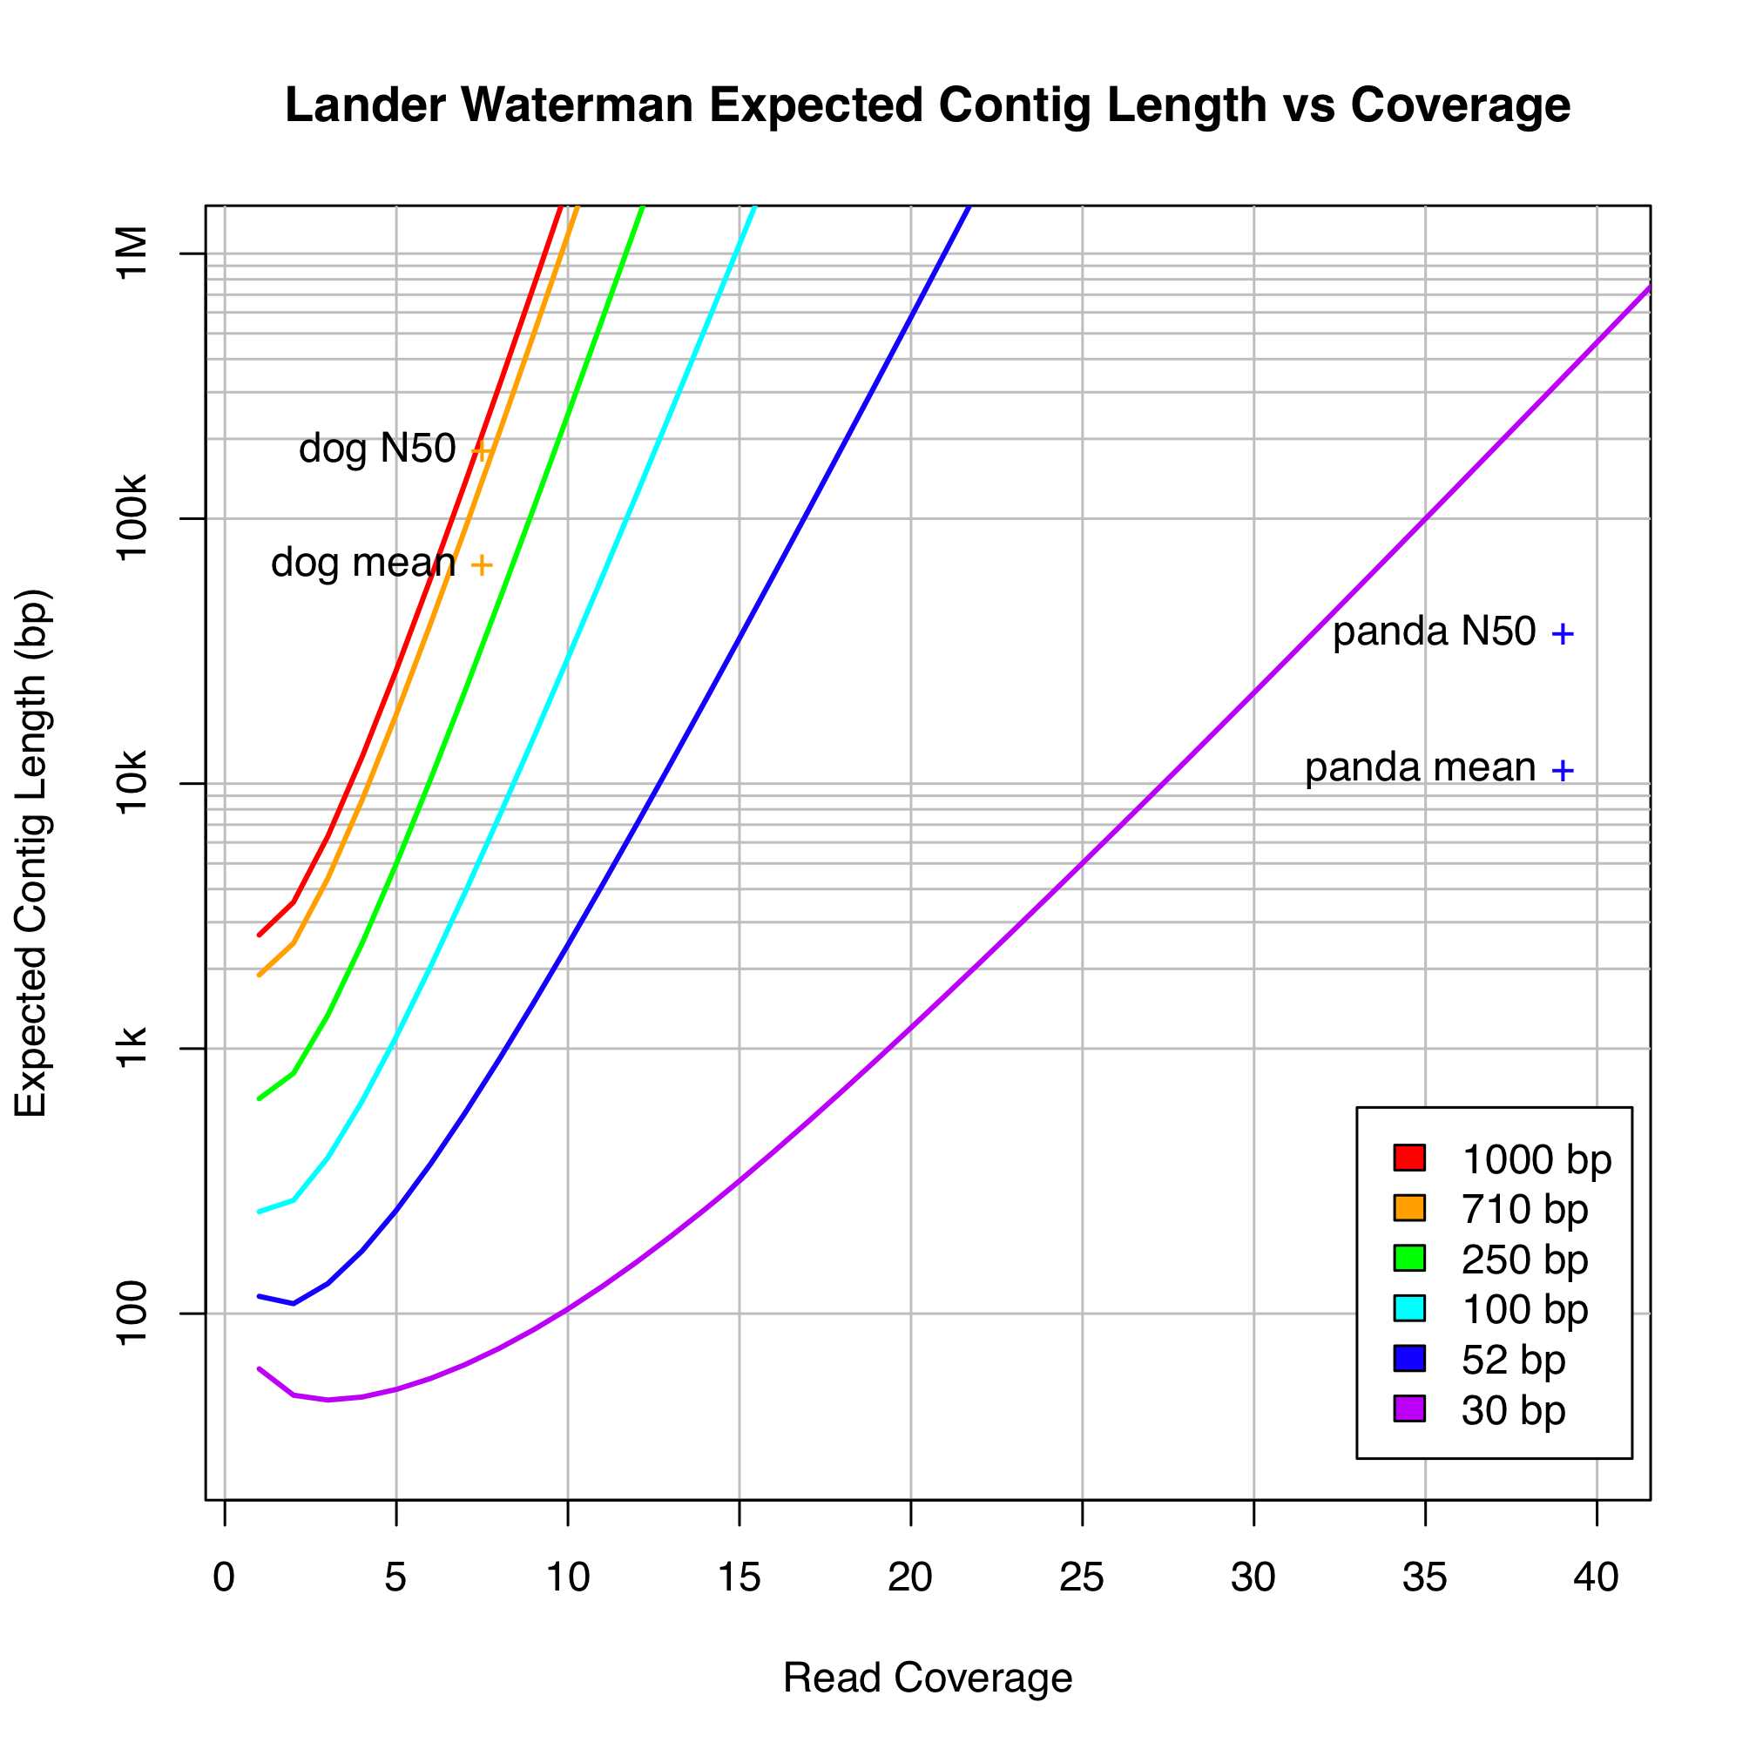
Genome Coverage
Idealized assembly
Uniform probability of a read starting at a given position
p = G/N
Poisson distribution in coverage along genome
Contigs end when there is no overlapping read
Contig length is a function of coverage and read length
Short reads require much higher coverage
Assembly of Large Genomes using Second Generation Sequencing
Schatz MC, Delcher AL, Salzberg SL (2010) Genome Research 20, 1165-73.

Slide 38
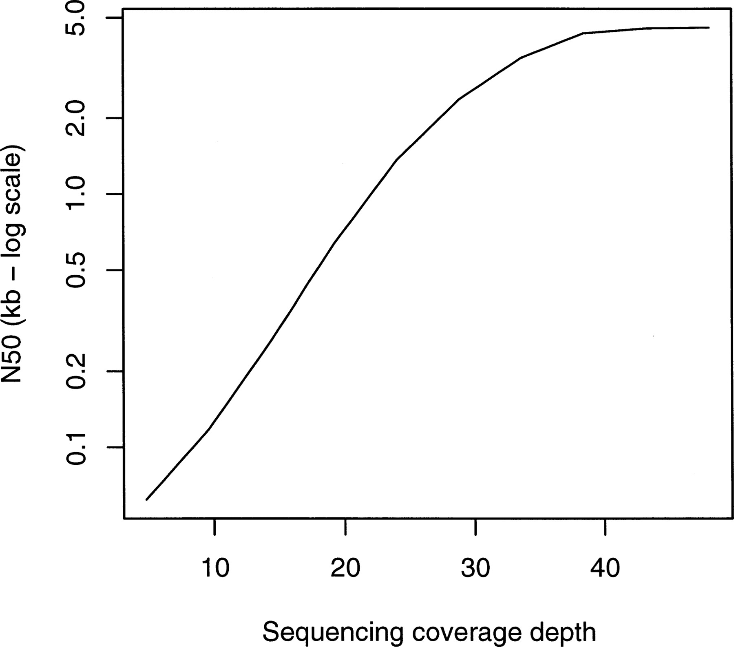
Effect of coverage on contig length with experimental Streptococcus data for Velvet
Zerbino D R , Birney E Genome Res. 2008;18:821-829
©2008 by Cold Spring Harbor Laboratory Press
Notes:
Effect of coverage on contig length with experimental Streptococcus data.

Slide 39
Two Paradigms for Assembly
a) Read Layout
b) Overlap Graph
R₁: GACCTACA
R₂: ACCTACAA
R₃: CCTACAAG
R₄: CTACAAGT
A: TACAAGTT
B: ACAAGTTA
C: CAAGTTAG
X: TACAAGTC
Y: ACAAGTCC
Z: CAAGTCCG
C
B
A
R₁
R₂
R₃
R₄
X
Y
Z
c) de Bruijn Graph
TAG
TTA
GTT
GAC
ACC
CCT
CTA
TAC
ACA
CAA
AAG
AGT
GTC
TCC
CCG
Assembly of Large Genomes using Second Generation Sequencing
Schatz MC, Delcher AL, Salzberg SL (2010) Genome Research 20, 1165-73.

