Slide 1
Hidden Markov Models (HMMs)
Steven Salzberg
CMSC 828H, Univ. of Maryland
Fall 2010

Slide 2
What are HMMs used for?
Real time continuous speech recognition (HMMs are the basis for all the leading products)
Eukaryotic and prokaryotic gene finding (HMMs are the basis of GENSCAN, Genie, VEIL, GlimmerHMM, TwinScan, etc.)
Multiple sequence alignment
Identification of sequence motifs
Prediction of protein structure

Slide 3
What is an HMM?
Essentially, an HMM is just
  A set of states
  A set of transitions between states
Transitions have
  A probability of taking a transition (moving from one state to another)
  A set of possible outputs
  Probabilities for each of the outputs
Equivalently, the output distributions can be attached to the states rather than the transitions

Slide 4
HMM notation
The set of all states: {s}
Initial states: S_{I}
Final states: S_{F}
Probability of making the transition from state i to j: a_{ij}
A set of output symbols
Probability of emitting the symbol k while making the transition from state i to j: b_{ij}(k)

Slide 5
HMM Example - Casino Coin
0.9
0.2
Two CDF tables
0.1
Fair
Unfair
State transition probs.
States
0.8
0.5
Symbol emission probs.
0.5
0.7
0.3
H
Observation Symbols
T
H
T
Observation Sequence
HTHHTTHHHTHTHTHHTHHHHHHTHTHH
FFFFFFUUUFFFFFFUUUUUUUFFFFFF
State Sequence
Motivation: Given a sequence of H & Ts, can you tell at what times the casino cheated?
Slide credit: Fatih Gelgi, Arizona State U.

Slide 6
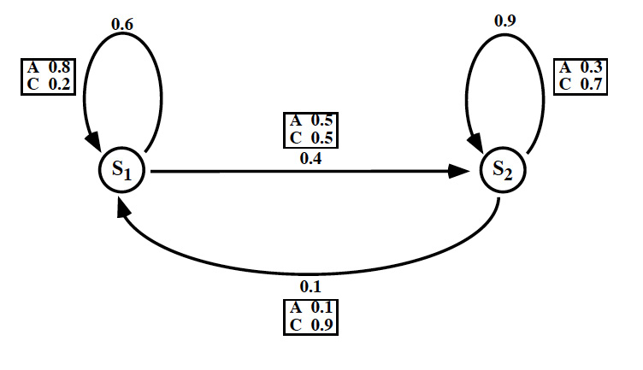
HMM example: DNA
Consider the sequence AAACCC, and assume that you observed this output from this HMM. What sequence of states is most likely?

Slide 7
Properties of an HMM
First-order Markov process
  s_{t} only depends on s_{t-1}
  However, note that probability distributions may contain conditional probabilities
Time is discrete
Slide credit: Fatih Gelgi, Arizona State U.

Slide 8
Three classic HMM problems
Evaluation: given a model and an output sequence, what is the probability that the model generated that output?
To answer this, we consider all possible paths through the model
A solution to this problem gives us a way of scoring the match between an HMM and an observed sequence
Example: we might have a set of HMMs representing protein families

Slide 9
Three classic HMM problems
Decoding: given a model and an output sequence, what is the most likely state sequence through the model that generated the output?
A solution to this problem gives us a way to match up an observed sequence and the states in the model.
In gene finding, the states correspond to sequence features such as start codons, stop codons, and splice sites

Slide 10
Three classic HMM problems
Learning: given a model and a set of observed sequences, how do we set the model’s parameters so that it has a high probability of generating those sequences?
This is perhaps the most important, and most difficult problem.
A solution to this problem allows us to determine all the probabilities in an HMMs by using an ensemble of training data

Slide 11
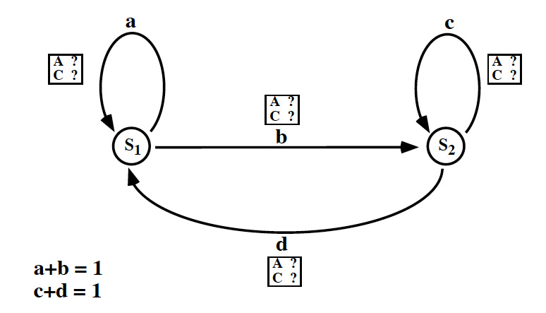
An untrained HMM

Slide 12
Basic facts about HMMs (1)
The sum of the probabilities on all the edges leaving a state is 1
… for any given state j

Slide 13
Basic facts about HMMs (2)
The sum of all the output probabilities attached to any edge is 1
… for any transition i to j

Slide 14
Basic facts about HMMs (3)
a_{ij} is a conditional probability; i.e., the probablity that the model is in state j at time t+1 given that it was in state i at time t

Slide 15
Basic facts about HMMs (4)
b_{ij}(k) is a conditional probability; i.e., the probablity that the model generated k as output, given that it made the transition i→j at time t

Slide 16
Why are these Markovian?
Probability of taking a transition depends only on the current state
  This is sometimes called the Markov assumption
Probability of generating Y as output depends only on the transition i→j, not on previous outputs
  This is sometimes called the output independence assumption
Computationally it is possible to simulate an n^{th} order HMM using a 0th order HMM
  This is how some actual gene finders (e.g., VEIL) work

Slide 17
Solving the Evaluation problem: the Forward algorithm
To solve the Evaluation problem, we use the HMM and the data to build a trellis
Filling in the trellis will give tell us the probability that the HMM generated the data by finding all possible paths that could do it

Slide 18
Our sample HMM
Let S₁ be initial state, S₂ be final state

Slide 19
A trellis for the Forward Algorithm
Time
t=0
t=1
t=2
t=3
S₁
1.0
(0.6)(0.8)(1.0)
0.48
+
State
(0.1)(0.1)(0)
(0.4)(0.5)(1.0)
+
S₂
0.0
0.20
(0.9)(0.3)(0)
A
C
C
Output:

Slide 20
A trellis for the Forward Algorithm
Time
t=0
t=1
t=2
t=3
S₁
1.0
(0.6)(0.8)(1.0)
0.48
(0.6)(0.2)(0.48)
.0576 + .018 = .0756
+
+
.0756
State
(0.1)(0.1)(0)
(0.1)(0.9)(0.2)
(0.4)(0.5)(1.0)
(0.4)(0.5)(0.48)
+
+
S₂
0.0
.126 + .096 = .222
0.20
.222
(0.9)(0.3)(0)
(0.9)(0.7)(0.2)
A
C
C
Output:

Slide 21
A trellis for the Forward Algorithm
Time
t=0
t=1
t=2
t=3
S₁
1.0
(0.6)(0.8)(1.0)
0.48
(0.6)(0.2)(0.48)
(0.6)(0.2)(.0756)
.009072 + .01998 = .029052
+
+
.0756
+
.029
State
(0.1)(0.1)(0)
(0.1)(0.9)(0.2)
(0.1)(0.9)(0.222)
(0.4)(0.5)(1.0)
(0.4)(0.5)(0.48)
(0.4)(0.5)(0.0756)
+
+
+
S₂
0.0
0.20
.13986 + .01512 = .15498
.222
.155
(0.9)(0.3)(0)
(0.9)(0.7)(0.2)
(0.9)(0.7)(0.222)
A
C
C
Output:

Slide 22
Forward algorithm: equations
sequence of length T:
all sequences of length T:
Path of length T+1 generates Y:
All paths:

Slide 23
Forward algorithm: equations
In other words, the probability of a sequence y being emitted by an HMM is the sum of the probabilities that we took any path that emitted that sequence.
* Note that all paths are disjoint - we only take 1 - so you can add their probabilities

Slide 24
Forward algorithm: transition probabilities
We re-write the first factor - the transition probability - using the Markov assumption, which allows us to multiply probabilities just as we do for Markov chains

Slide 25
Forward algorithm: output probabilities
We re-write the second factor - the output probability - using another Markov assumption, that the output at any time is dependent only on the transition being taken at that time

Slide 26
Substitute back to get computable formula
This quantity is what the Forward algorithm computes, recursively.
*Note that the only variables we need to consider at each step are y_{t}, x_{t}, and x_{t+1}

Slide 27
Forward algorithm: recursive formulation
Where α_{i}(t) is the probability that the HMM is in state i after generating the sequence y₁,y₂,…,y_{t}

Slide 28
Probability of the model
The Forward algorithm computes P(y|M)
If we are comparing two or more models, we want the likelihood that each model generated the data: P(M|y)
Use Bayes’ law:
Since P(y) is constant for a given input, we just need to maximize P(y|M)P(M)

