Slide 1
Three classic HMM problems
Decoding: given a model and an output sequence, what is the most likely state sequence through the model that generated the output?
A solution to this problem gives us a way to match up an observed sequence and the states in the model.
In gene finding, the states correspond to sequence features such as start codons, stop codons, and splice sites

Slide 2
Three classic HMM problems
Learning: given a model and a set of observed sequences, how do we set the model’s parameters so that it has a high probability of generating those sequences?
This is perhaps the most important, and most difficult problem.
A solution to this problem allows us to determine all the probabilities in an HMMs by using an ensemble of training data

Slide 3
Viterbi algorithm
Where V_{i}(t) is the probability that the HMM is in state i after generating the sequence y₁,y₂,…,y_{t,} following the most probable path in the HMM

Slide 4
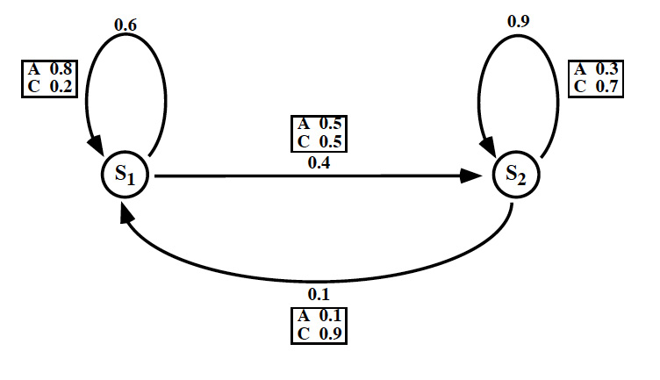
Our sample HMM
Let S₁ be initial state, S₂ be final state

Slide 5
A trellis for the Viterbi Algorithm
Time
t=0
t=1
t=2
t=3
S₁
1.0
(0.6)(0.8)(1.0)
0.48
max
State
(0.1)(0.1)(0)
(0.4)(0.5)(1.0)
S₂
0.0
max
0.20
(0.9)(0.3)(0)
A
C
C
Output:

Slide 6
A trellis for the Viterbi Algorithm
Time
t=0
t=1
t=2
t=3
S₁
1.0
(0.6)(0.8)(1.0)
0.48
(0.6)(0.2)(0.48)
max(.0576,.018) = .0576
.0576
max
max
State
(0.1)(0.1)(0)
(0.1)(0.9)(0.2)
(0.4)(0.5)(1.0)
(0.4)(0.5)(0.48)
S₂
max
max
0.0
0.20
max(.126,.096) = .126
.126
(0.9)(0.3)(0)
(0.9)(0.7)(0.2)
A
C
C
Output:

Slide 7
Learning in HMMs: the E-M algorithm
In order to learn the parameters in an “empty” HMM, we need:
  The topology of the HMM
  Data - the more the better
The learning algorithm is called “Estimate-Maximize” or E-M
  Also called the Forward-Backward algorithm
  Also called the Baum-Welch algorithm

Slide 8
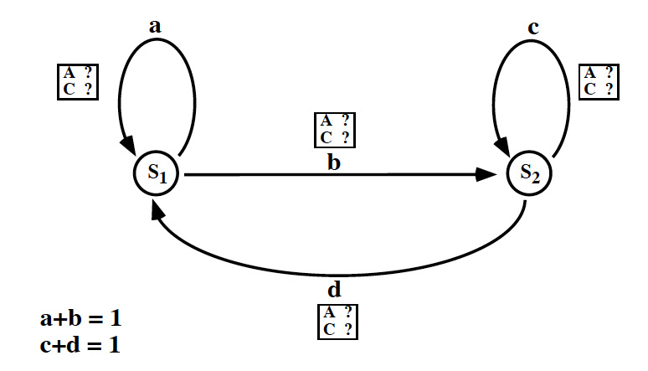
An untrained HMM

Slide 9
Some HMM training data
CACAACAAAACCCCCCACAA
ACAACACACACACACACCAAAC
CAACACACAAACCCC
CAACCACCACACACACACCCCA
CCCAAAACCCCAAAAACCC
ACACAAAAAACCCAACACACAACA
ACACAACCCCAAAACCACCAAAAA

Slide 10
Step 1: Guess all the probabilities
We can start with random probabilities, the learning algorithm will adjust them
If we can make good guesses, the results will generally be better

Slide 11
Step 2: the Forward algorithm
Reminder: each box in the trellis contains a value α_{i}(t)
α_{i}(t) is the probability that our HMM has generated the sequence y₁, y₂, …, y_{t} and has ended up in state i.

Slide 12
Reminder: notations
sequence of length T:
all sequences of length T:
Path of length T+1 generates Y:
All paths:

Slide 13
Step 3: the Backward algorithm
Next we need to compute β_{i}(t) using a Backward computation
β_{i}(t) is the probability that our HMM will generate the rest of the sequence y_{t+1},y_{t+2}, …, y_{T} beginning in state i

Slide 14
A trellis for the Backward Algorithm
Time
t=0
t=1
t=2
t=3
S₁
0.2
(0.6)(0.2)(0.0)
0.0
+
State
(0.1)(0.9)(0)
(0.4)(0.5)(1.0)
S₂
+
0.63
1.0
(0.9)(0.7)(1.0)
A
C
C
Output:

Slide 15
A trellis for the Backward Algorithm (2)
Time
t=0
t=1
t=2
t=3
S₁
.024 + .126 = .15
.15
(0.6)(0.2)(0.2)
0.2
(0.6)(0.2)(0.0)
0.0
+
+
State
(0.1)(0.9)(0.2)
(0.4)(0.5)(0.63)
(0.1)(0.9)(0)
(0.4)(0.5)(1.0)
S₂
+
+
.397 + .018 = .415
.415
0.63
1.0
(0.9)(0.7)(0.63)
(0.9)(0.7)(1.0)
A
C
C
Output:

Slide 16
A trellis for the Backward Algorithm (3)
Time
t=0
t=1
t=2
t=3
S₁
.072 + .083 = .155
.155
(0.6)(0.8)(0.15)
.15
(0.6)(0.2)(0.2)
0.2
(0.6)(0.2)(0.0)
0.0
+
+
State
(0.1)(0.1)(0.15)
(0.4)(0.5)(0.415)
(0.1)(0.9)(0.2)
(0.4)(0.5)(0.63)
(0.1)(0.9)(0)
(0.4)(0.5)(1.0)
S₂
.112 + .0015 = .1135
+
+
.114
(0.9)(0.3)(0.415)
.415
0.63
1.0
(0.9)(0.7)(0.63)
(0.9)(0.7)(1.0)
A
C
C
Output:

Slide 17
Step 4: Re-estimate the probabilities
After running the Forward and Backward algorithms once, we can re-estimate all the probabilities in the HMM
α_{SF} is the prob. that the HMM generated the entire sequence
Nice property of E-M: the value of α_{SF} never decreases; it converges to a local maximum
We can read off α and β values from Forward and Backward trellises

Slide 18
Compute new transition probabilities
γ is the probability of making transition i-j at time t, given the observed output
  γ is dependent on data, plus it only applies for one time step; otherwise it is just like a_{ij}(t)

Slide 19
What is gamma?
Sum γ over all time steps, then we get the expected number of times that the transition i-j was made while generating the sequence Y:

Slide 20
How many times did we leave i?
Sum γ over all time steps and all states that can follow i, then we get the expected number of times that the transition i-x as made for any state x:

Slide 21
Recompute transition probability
In other words, probability of going from state i to j is estimated by counting how often we took it for our data (C1), and dividing that by how often we went from i to other states (C2)

Slide 22
Recompute output probabilities
Originally these were b_{ij}(k) values
We need:
  expected number of times that we made the transition i-j and emitted the symbol k
  The expected number of times that we made the transition i-j

Slide 23
New estimate of b_{ij}(k)

Slide 24
Step 5: Go to step 2
Step 2 is Forward Algorithm
Repeat entire process until the probabilities converge
  Usually this is rapid, 10-15 iterations
“Estimate-Maximize” because the algorithm first estimates probabilities, then maximizes them based on the data
“Forward-Backward” refers to the two computationally intensive steps in the algorithm

Slide 25
Computing requirements
Trellis has N nodes per column, where N is the number of states
Trellis has S columns, where S is the length of the sequence
Between each pair of columns, we create E edges, one for each transition in the HMM
Total trellis size is approximately S(N+E)

