Slide 1
Genome sizes (sample)

Slide 2
Some genomics history
1995: first bacterial genome, Haemophilus influenza, 1.8 Mbp, sequenced at TIGR
first use of whole-genome shotgun for a bacterium
Fleischmann et al. 1995 became most-cited paper of the year (>3000 citations)
1995-6: 2nd and 3rd bacteria published by TIGR: Mycoplasma genitalium, Methanococcus jannaschii
1996: first eukaryote, S. cerevisiae (yeast), 13 Mbp, sequenced by a consortium of (mostly European) labs
1997: E. coli finished (7th bacterial genome)
1998-2001: T. pallidum (syphilis), B. burgdorferi (Lyme disease), M. tuberculosis, Vibrio cholerae, Neisseria meningitidis, Streptococcus pneumoniae, Chlamydia pneumoniae [all at TIGR]
2000: fruit fly, Drosophila melanogaster
2000: first plant genome, Arabidopsis thaliana
2001: human genome, first draft
2002: malaria genome, Plasmodium falciparum
2002: anthrax genome, Bacillus anthracis
TODAY (Sept 1, 2010):
1214 complete microbial genomes! (two years ago: 700)
3424 microbial genomes in progress! (two years ago: 1199)
838 eukaryotic genomes complete or in progress! (two years ago: 476)

Slide 4
New directions: sequencing ancient DNA (some assembly required)

Slide 5
J. P. Noonan et al., Science 309, 597 -599 (2005)

Slide 6
Fig. 1. Schematic illustration of the ancient DNA extraction and library construction process
J. P. Noonan et al., Science 309, 597 -599 (2005)
Published by AAAS

Slide 7
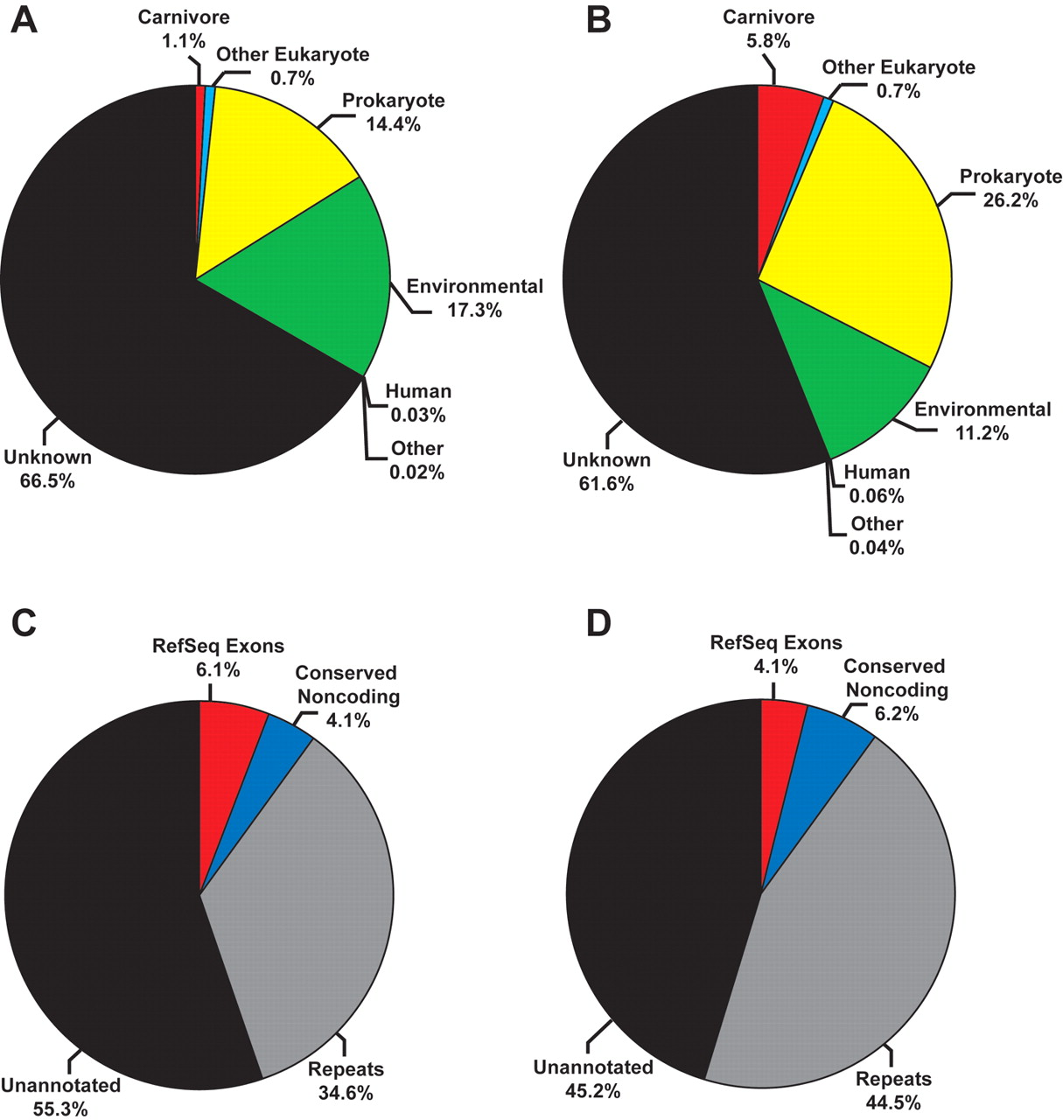
Fig. 2. Characterization of two independent cave bear genomic libraries
Fig. 2. Predicted origin of 9035 clones from library CB1 (A) and 4992 clones from library CB2 (B) are shown, as determined by BLAST comparison to GenBank and environmental sequence databases. Other refers to viral or plasmid-derived DNAs. Distribution of sequence annotation features in 6,775 nucleotides of carnivore sequence from library CB1 (C) and 20,086 nucleotides of carnivore sequence from library CB2 (D) are shown as determined by alignment to the July 2004 dog genome assembly.
J. P. Noonan et al., Science 309, 597 -599 (2005)
Published by AAAS

Slide 10
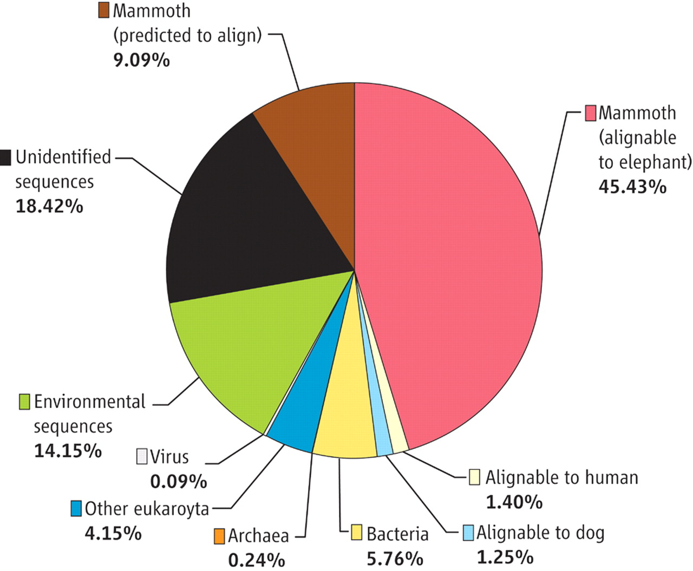
Fig. 1. Characterization of the mammoth metagenomic library, including percentage of read distributions to various taxa
H. N. Poinar et al., Science 311, 392 -394 (2006)
Published by AAAS

Slide 11
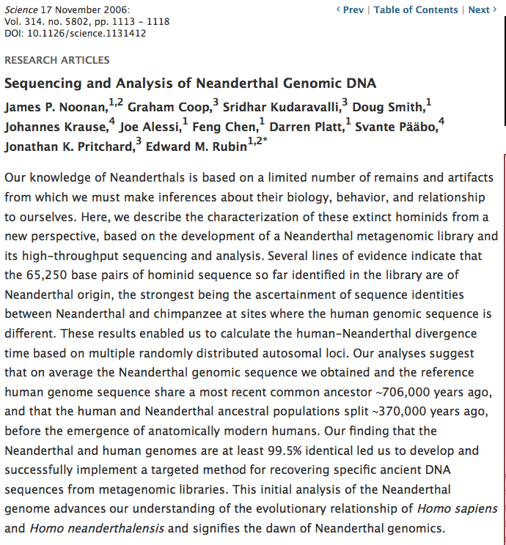

Slide 12
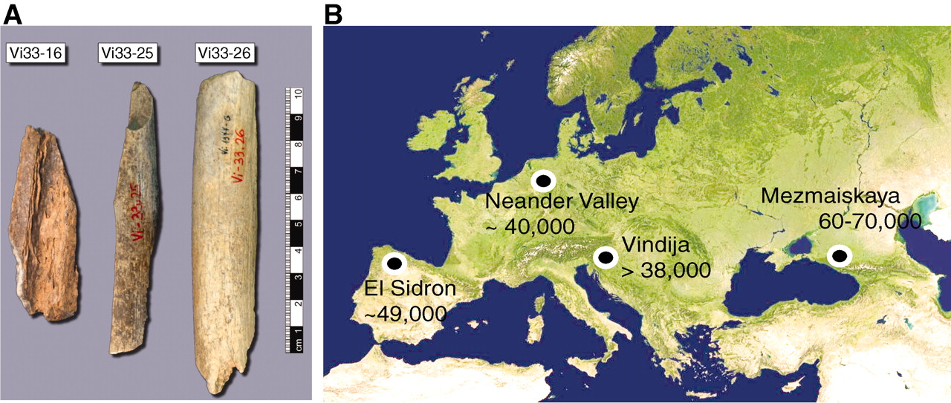
A Draft Sequence of the Neandertal Genome
Richard E. Green et al., Science 7 May 2010
Fig. 1 Samples and sites from which DNA was retrieved
R. E. Green et al., Science 328, 710-722 (2010)
Published by AAAS

Slide 13
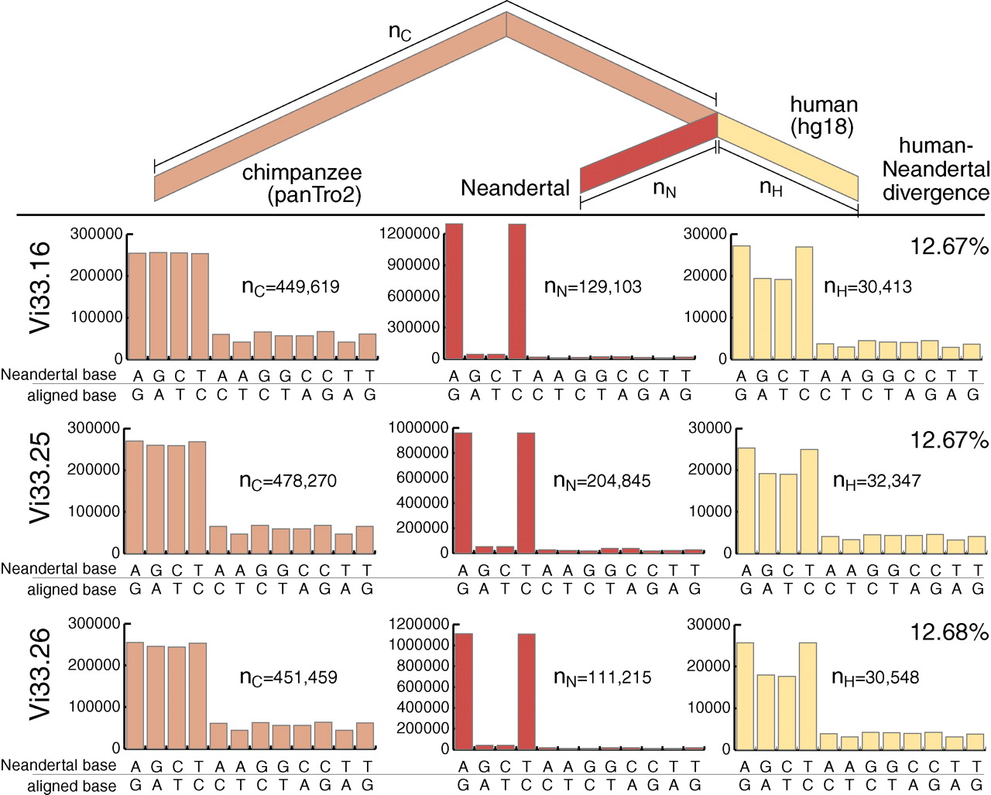
Fig. 2 Nucleotide substitutions inferred to have occurred on the evolutionary lineages leading to the Neandertals, the human, and the chimpanzee genomes
R. E. Green et al., Science 328, 710-722 (2010)
Published by AAAS

Slide 14
Journals
The very best:
Science
www.sciencemag.org
Nature
www.nature.com/nature
PLoS Biology
www.plosbiology.org

Slide 15
Bioinformatics Journals
Bioinformatics
bioinformatics.oxfordjournals.org
BMC Bioinformatics
www.biomedcentral.com/bioinformatics
PLoS Computational Biology
compbiol.plosjournals.org
Journal of Computational Biology
www.liebertpub.com/cmb

Slide 16
Radically new journals
PLoS ONE
www.plosone.org
Biology Direct
www.biology-direct.com
Reviewers’ comments are public
Both journals can be annotated by readers
Papers can be negative results, confirmations of other results, or brand new

Slide 17
Genomics Journals (which publish computational biology papers)
Genome Biology
genomebiology.com
Genome Research
www.genome.org
Nucleic Acids Research
nar.oxfordjournals.org
BMC Genomics
www.biomedcentral.com/bmcgenomics

Slide 18
Before assembly…
… we need to cover a basic sequence alignment algorithm

Slide 19
PAIRWISE ALIGNMENT (ALIGNMENT OF TWO NUCLEOTIDE OR TWO AMINO-ACID SEQUENCES)
This and the following slides are borrowed from
Prof. Dan Graur, Univ. of Houston

Slide 20
ancestor
Any two organisms or two sequences share a common ancestor in their past
descendant 1
descendant 2

Slide 21
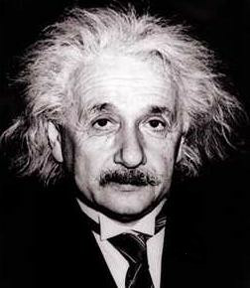
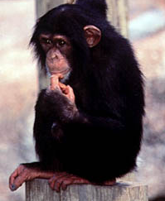
ancestor
(5 MYA)

Slide 22
(120 MYA)
ancestor

Slide 23
(1,500 MYA)
ancestor

Slide 24
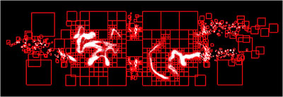
Homology
By comparing homologous characters, we can reconstruct the evolutionary events that have led to the formation of the extant sequences from the common ancestor.

Slide 25
Sequence alignment involves the identification of the correct location of deletions and insertions that have occurred in either of the two lineages since their divergence from a common ancestor.

Slide 26
ACTGGGCCCAAATC
1 deletion
1 substitution
1 insertion
1 substitution
CTGGGCCCAGATC
AACAGGGCCCAAATC
Correct alignment
-CTGGGCCCAGATC
ACTGGGCCCAAATC
*********.***

Slide 27
There are two modes of alignment.
Local alignment determines if sub-segments of one sequence (A) are present in another (B). Local alignment methods have their greatest utility in database searching and retrieval (e.g., BLAST).
In global alignment, each element of sequence A is compared with each element in sequence B. Global alignment algorithms are used in comparative and evolutionary studies.

Slide 28
A pairwise alignment consists of a series of paired bases, one base from each sequence. There are three types of pairs: (1) matches = the same nucleotide appears in both sequences. (2) mismatches = different nucleotides are found in the two sequences. (3) gaps = a base in one sequence and a null base in the other.
GCGGCCCATCAGGTAGTTGGTG-G
GCGTTCCATC--CTGGTTGGTGTG

Slide 29
Motivation for sequence alignment
Study function
Sequences that are similar probably have similar functions.
Study evolution
Similarity is mostly indicative of common ancestry.

Slide 30
An example of pairwise alignment of an unknown protein with a known one
Glutaredoxin, Bacteriophage T4 from E. coli, 87 aa
(B) Unknown protein - 93 aa
Unknown protein, Bacteriophage 65 from Aeromonas sp. 93 aa
10 20 30 40 50 Glutar KVYGYDSNIHKCVYCDNAKRLLTVKKQPFEFINIMPEKGV---FDD—EKIAELLTKLGR ..:: .. :: : .: :: : .:.: .. . . :: ::. : .. . Unknow EIYGIPEDVAKCSGCISAIRLCFEKGYDYEIIPVLKKANNQLGFDYILEKFDECKARANM
10 20 30 40 50 60
60 70 80 Glutar DTQIGLTMPQVFAPDGSHIGGFDQLREYF .:. ..:..:. ::..::.. :... . Unknow QTR-PTSFPRIFV-DGQYIGSLKQFKDLY
70 80 90
Is the unknown protein
a glutaredoxin?

Slide 31
Alignment algorithms

Slide 32
Aim: Given certain criteria, find the alignment associated with the best score from among all possible alignments. The OPTIMAL ALIGNMENT

Slide 33
The number of possible alignments may be astronomical.
where n and m are the lengths of the two sequences to be aligned.

Slide 34
The number of possible alignments may be astronomical. For example, when two sequences 300 residues long each are compared, there are 10⁸⁸ possible alignments. In comparison, the number of elementary particles in the universe is only ~10⁸⁰.

Slide 35
The Needleman-Wunsch (1970) algorithm uses Dynamic Programming

Slide 36
Dynamic programming can be applied to problems of alignment because ALIGNMENT SCORES obey the following rules:

Slide 38
Wunsch Algorithm

Slide 40
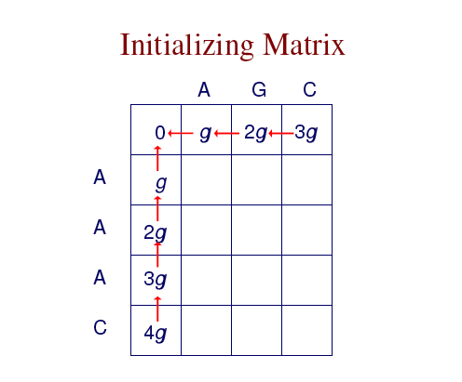

Slide 41
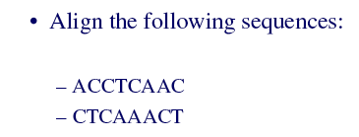

Slide 42
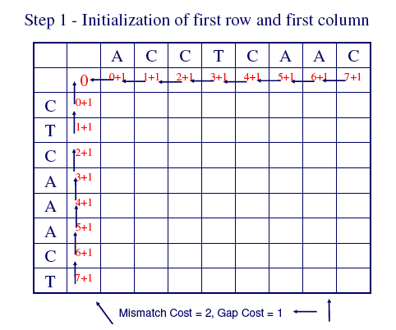

Slide 43
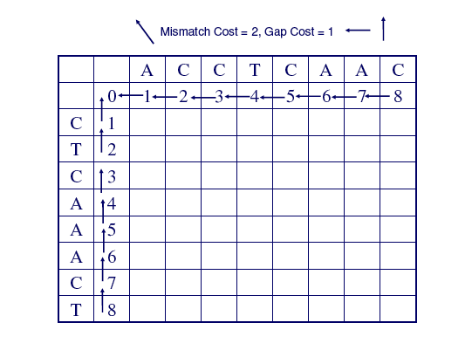

Slide 44
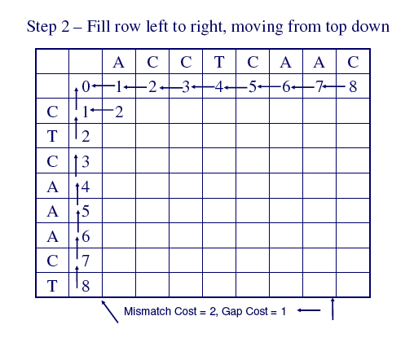

Slide 45
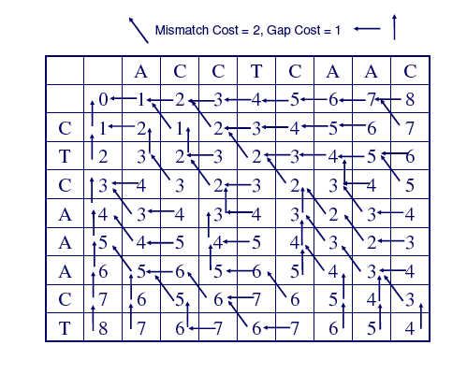

Slide 46
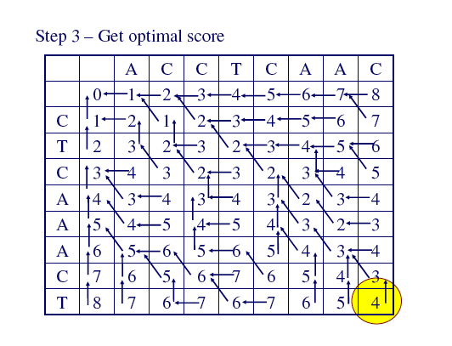

Slide 47
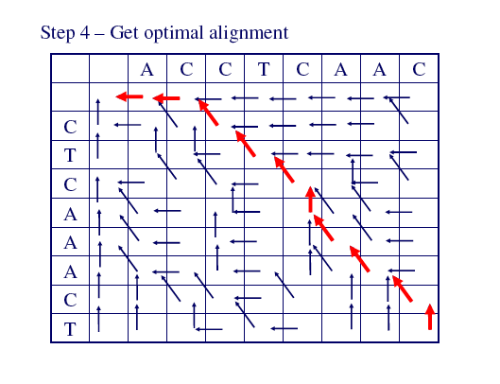
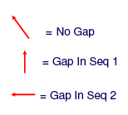

Slide 48
The alignment is produced by starting at the minimum score in either the rightmost column or the bottom row, and following the back pointers. This stage is called traceback.

Slide 49
A Multiple Alignment

Slide 50
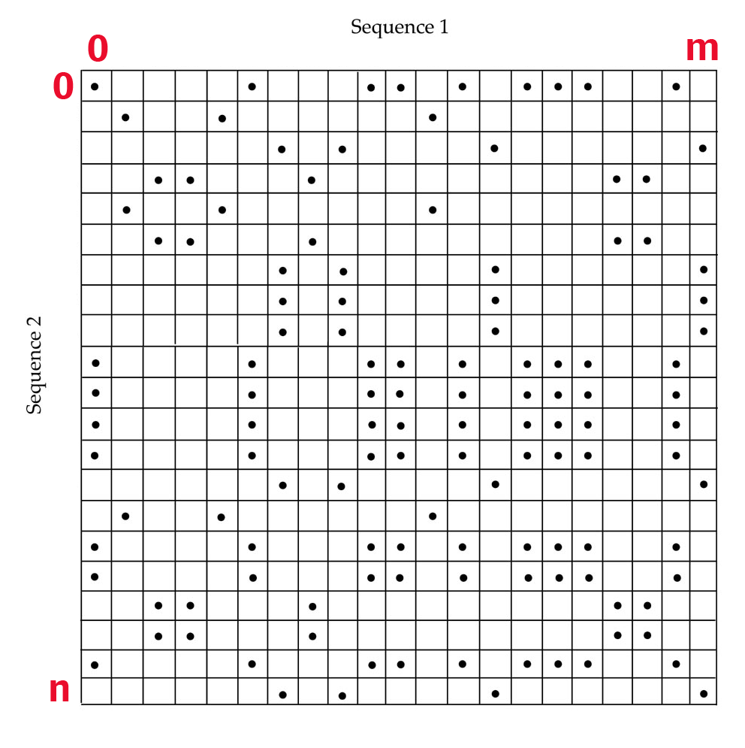
Local vs. Global Alignment
A Global Alignment algorithm will find the optimal path between vertices (0,0) and (n,m) in the dynamic programming matrix.
A Local Alignment algorithm will find the optimal-scoring alignment between arbitrary vertices (i,j) and (k,l) in the dynamic programming matrix.

Slide 51
Local vs. Global Alignment
Global Alignment
Local Alignment—better alignment to find conserved segment
--T—-CC-C-AGT—-TATGT-CAGGGGACACG—A-GCATGCAGA-GAC
| || | || | | | ||| || | | | | |||| |
AATTGCCGCC-GTCGT-T-TTCAG----CA-GTTATG—T-CAGAT--C
tccCAGTTATGTCAGgggacacgagcatgcagagac
||||||||||||
aattgccgccgtcgttttcagCAGTTATGTCAGatc

